Slide 1
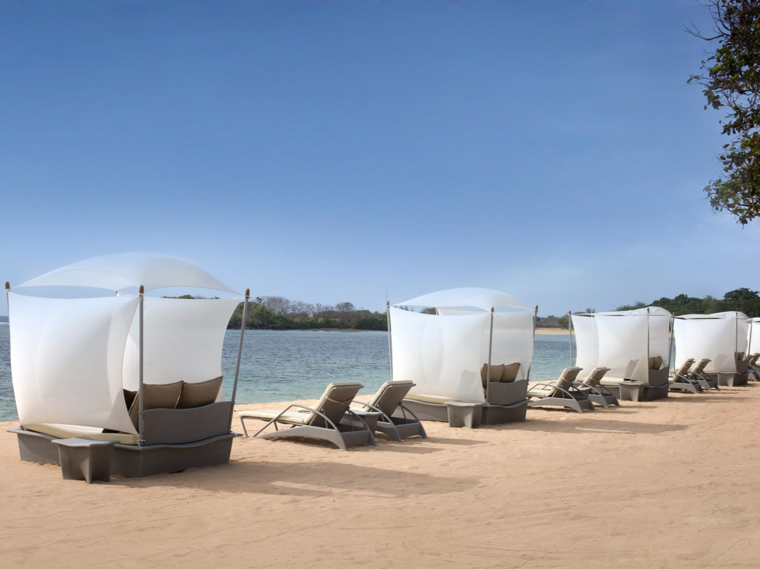
The Westin Resort Nusa Dua, Bali
Bali, Indonesia
©2018 Marriott International, Inc. All Rights Reserved. For internal use only. CONFIDENTIAL & PROPRIETARY – May not be reproduced, disclosed or distributed without the express written permission of Marriott International, Inc.

Slide 2
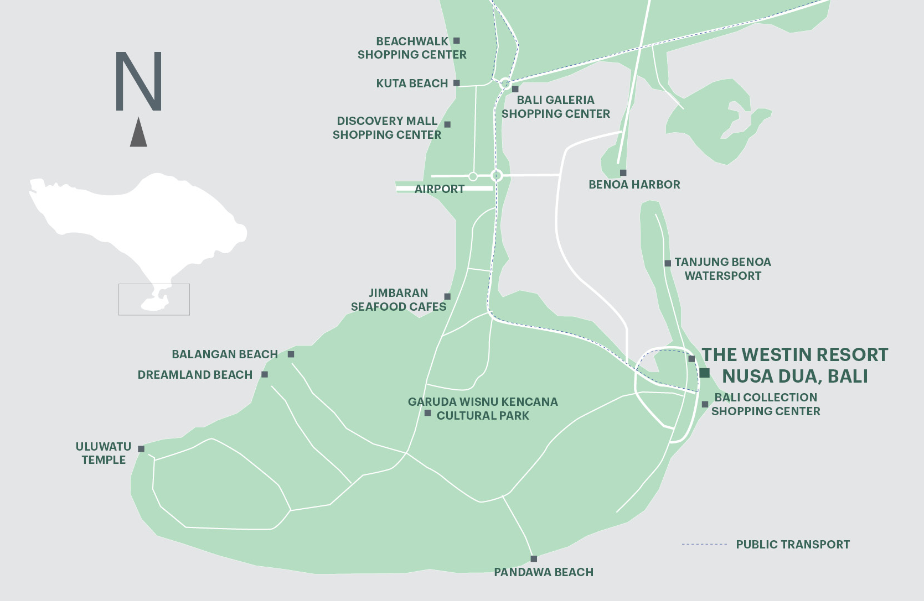
Location

Slide 3
SUNRISE AT THE WESTIN RESORT NUSA DUA, BALI

Slide 4
RESORT FACADE

Slide 5
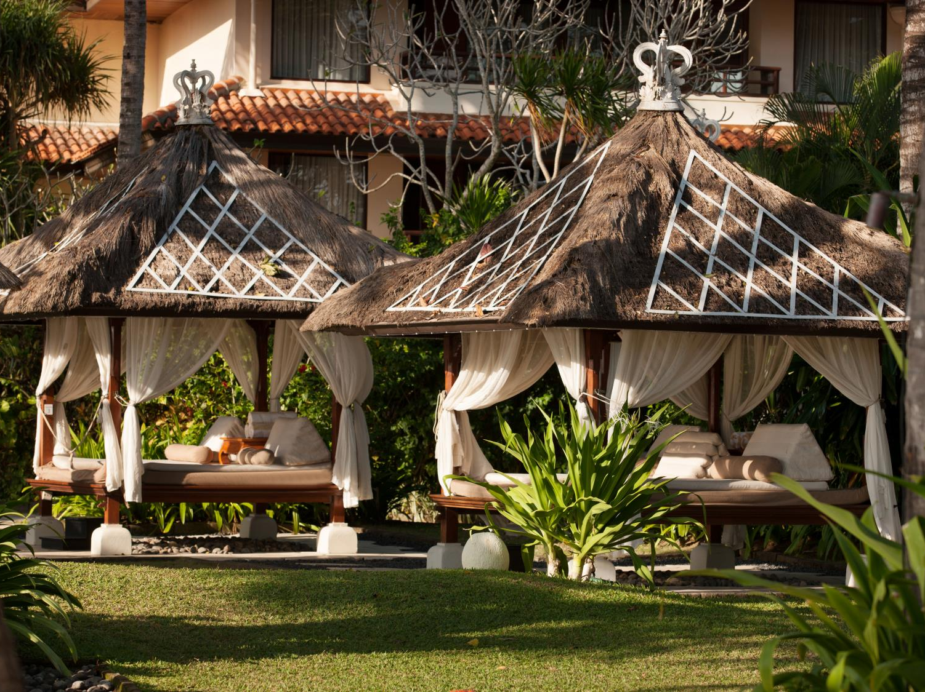
SPA BALE AT BEACHFRONT

Slide 6
TERRACE WITH TROPICAL GARDEN

Slide 7
SUNRISE AT NUSA DUA BEACH, BALI

Slide 8
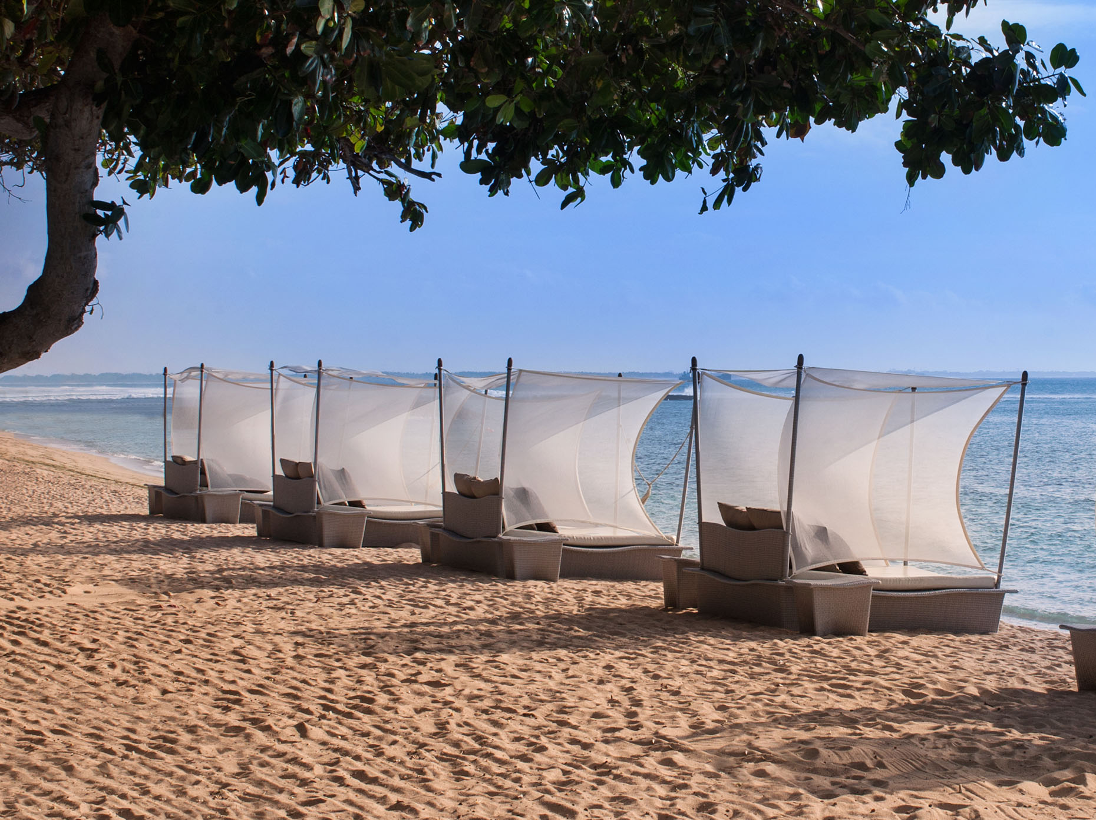
NUSA DUA BEACH, BALI

Slide 9
NUSA DUA BEACH, BALI

Slide 10
LOBBY

Slide 11
LOBBY

Slide 12
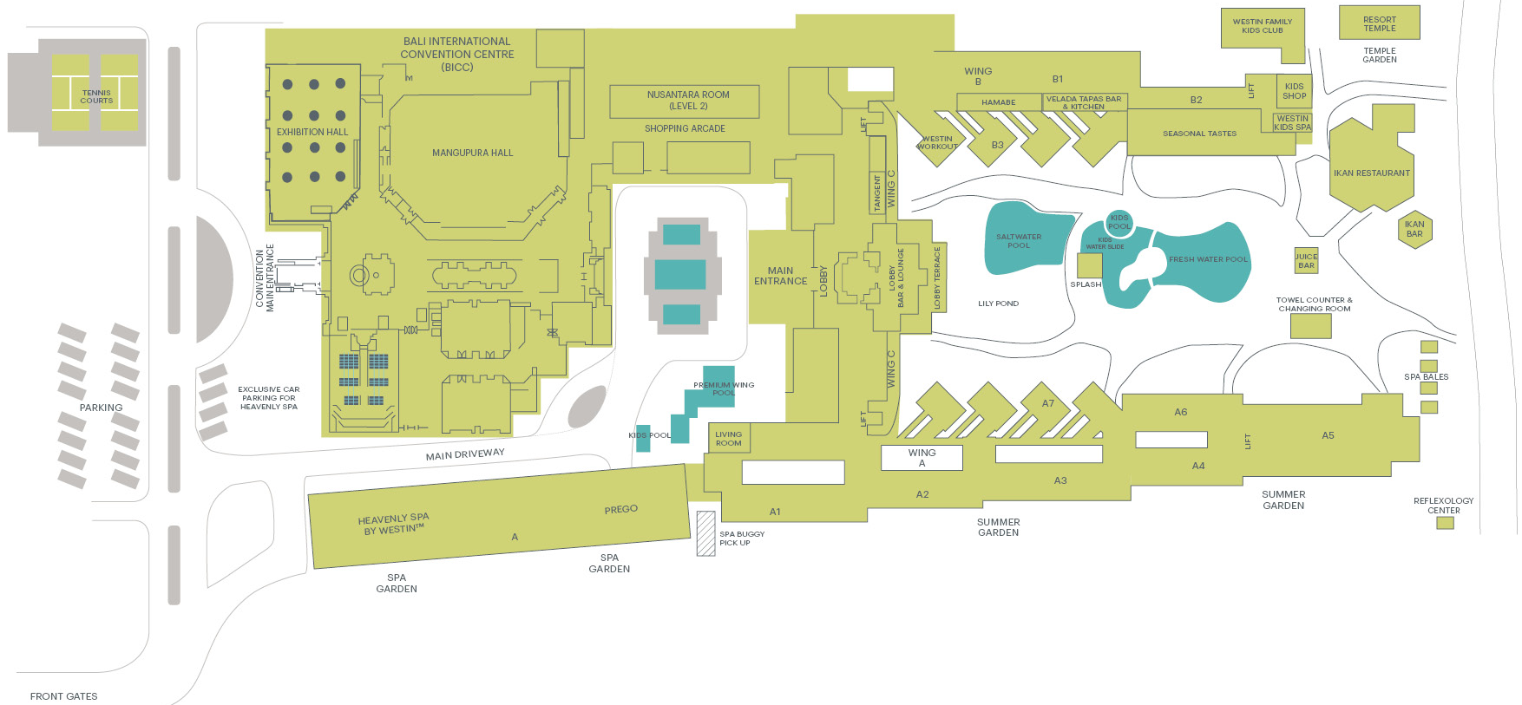
Resort Map

Slide 13
Kids Welcome
For our young customers, Westin offers a dedicated Kids Check-in Corner. Our family friendly resort offers an assortment of complimentary facilities for young travelers, including a 12-metre waterslide in the freshwater pool. Set in a quiet garden corner and shaded by tropical greenery, we offer more than just a playground for children. The Westin Family kids club is an interactive environment that offers fun, games and educational activities courtesy of Westin.

Slide 14
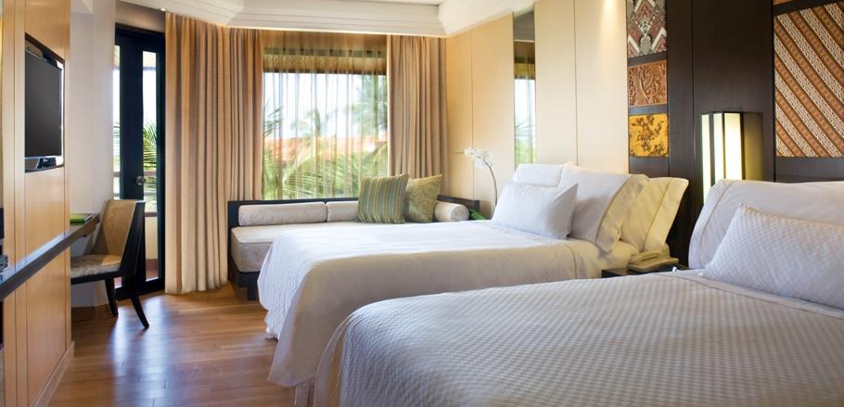
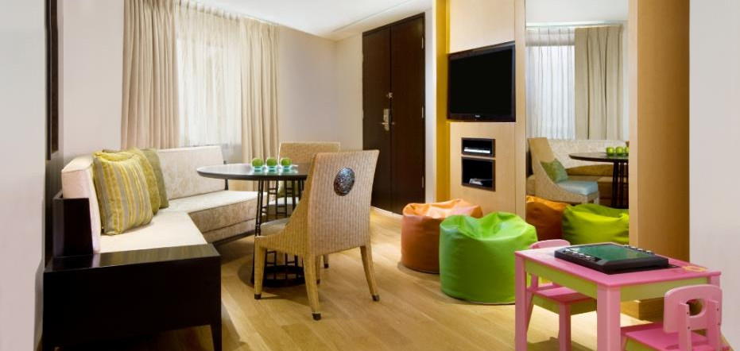
Family Suite
Our expansive Family Suite is designed to make traveling with kids a whole lot easier. This Bali family accommodation category comes with two private bedrooms and a separate living area. There’s plenty of space for everyone to relax and recharge after a fun day out in the tropics. The suite even features a DVD player and assorted board games to keep youngsters entertained for hours. A daybed in the kid’s room is large enough to sleep an adult. (1,259 Square Feet / 117 Square Meters)

Slide 16
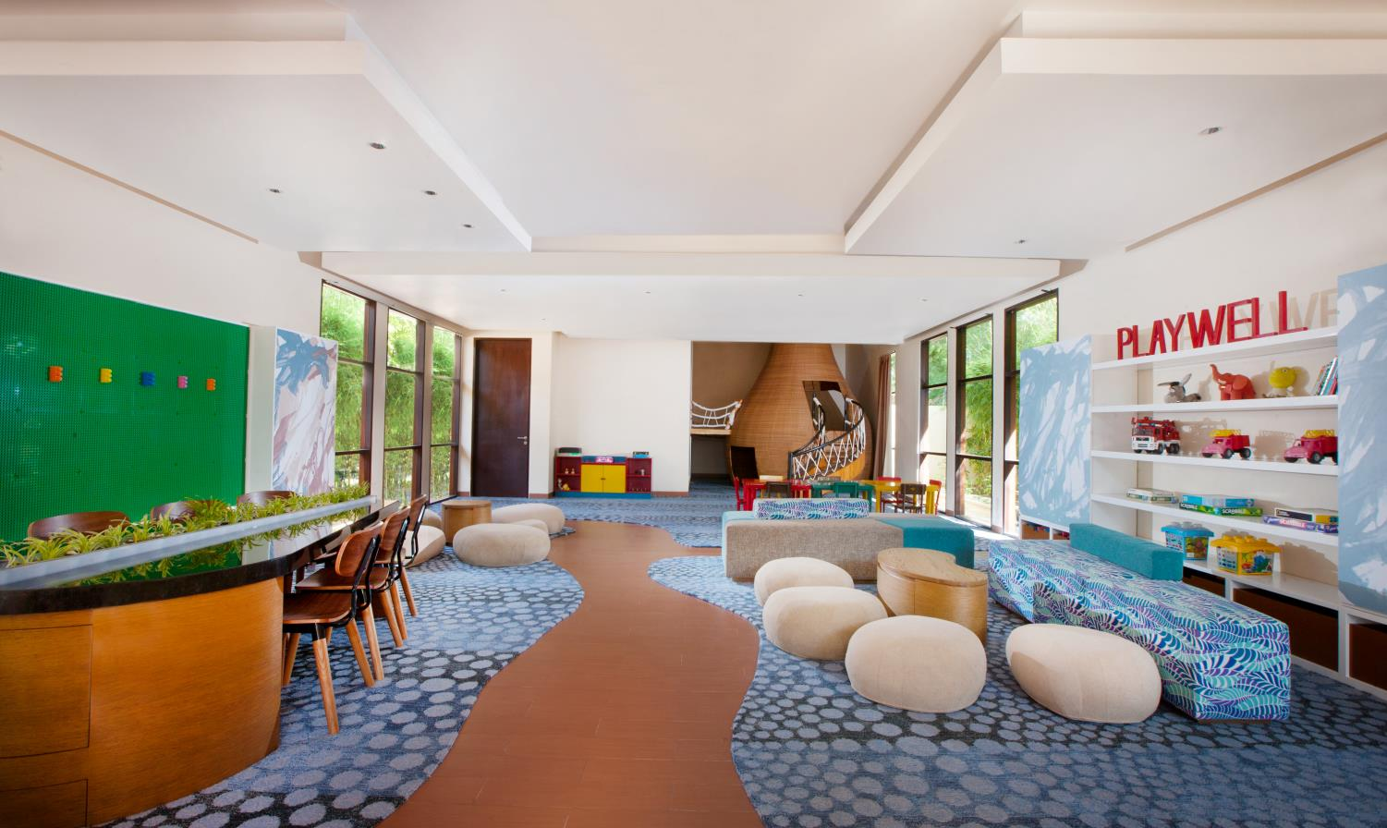
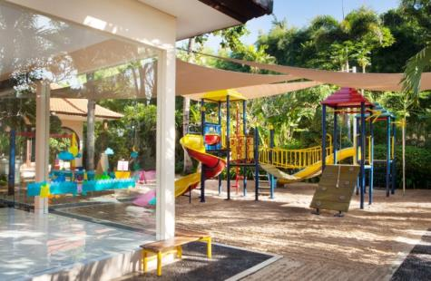
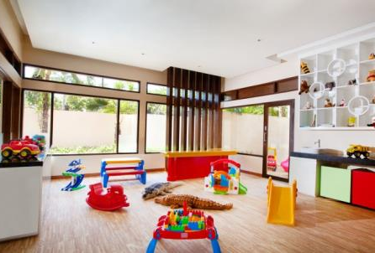
Westin Family Kids Club
Our family friendly resort in Bali offers an assortment of complimentary facilities just for young travelers. There is Westin Family kids club, a supervised center with games, toys and enriching activities to give parents complete peace of mind.
Renowned as one of the most desirable Bali family resorts in the area, the spacious outdoor playground caters to children between the ages of 4 - 12 years and features fun activities such as face painting, kite making, fishing, movie night, stargazing and much more.

Slide 17
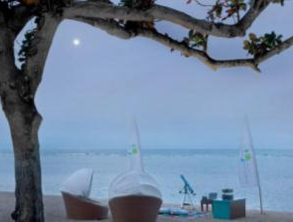
Kids Club Program Highlights
Parent’s Night out*
Enjoy a relaxing evening out as we entertain your children with an array of fun activities at our kids club.
*Subject to availability and prior reservation is required.
Kids Yoga - Our yoga master will conduct a guided session of gentle stretching and breathing exercises especially for youngsters. Recommended for age 6 upwards.
Star Gazing - Use a map of the sky to view the stars and learn how the different constellations were interpreted by local cultures.
BALINESE DANCE - discover the graceful movements of traditional Balinese dance and amaze everyone with your newfound talent.
KITE FLYING - appreciate the traditional artistry of Balinese kites and learn how to catch the seasonal winds.
Movie night - enjoy a selection of family-friendly movies screened in a communal setting with other children from around the world.

Slide 18
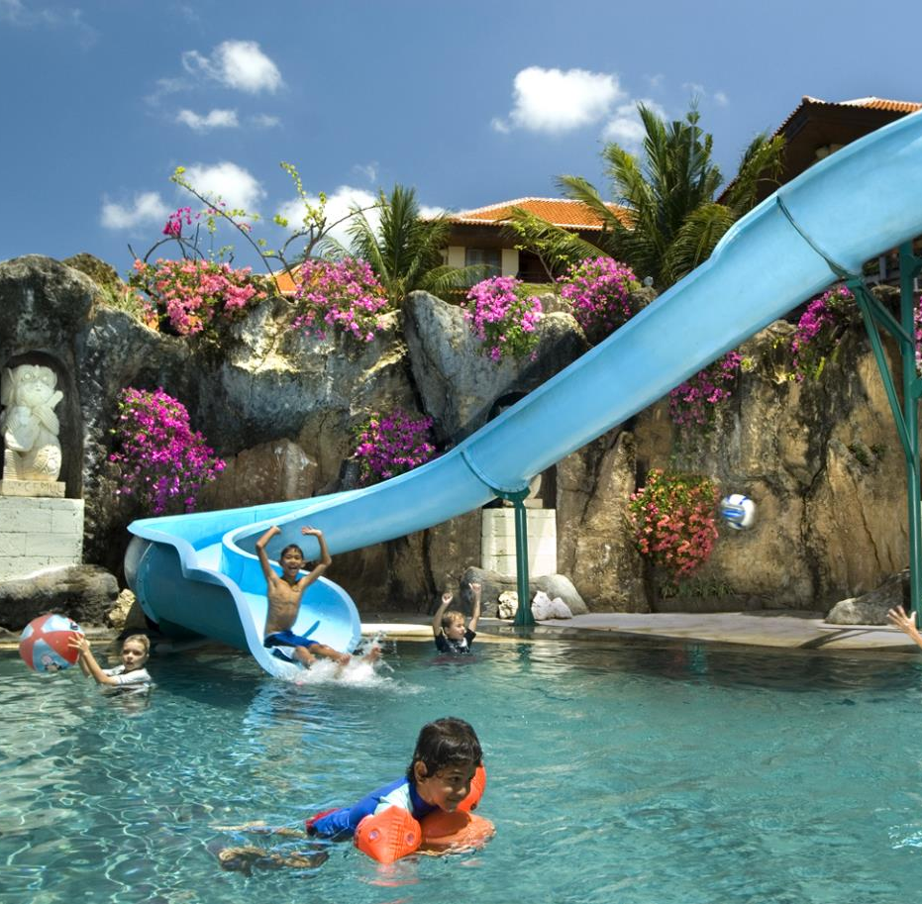
Let’s Get Wet
Spacious free-form freshwater pool with 12-meter water slide, salt-water relaxation pool, waterfalls and a children’s pool just meters away from golden sand beachfront for sunbathing, swimming and reef snorkeling. Various water sports including wind surfing, jet skiing and scuba diving are available just off the resort beachfront.

Slide 19
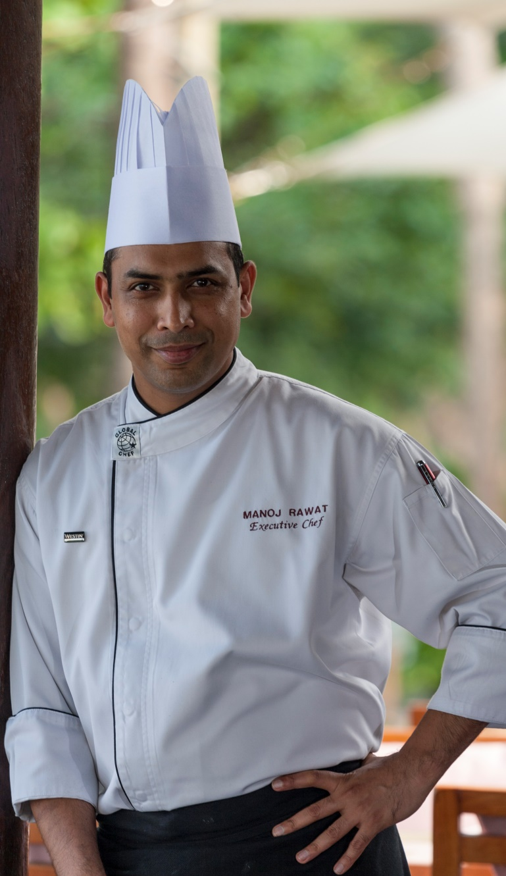
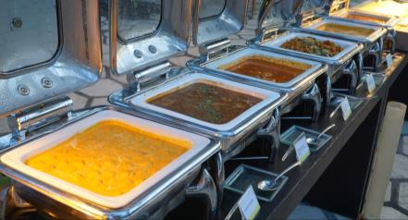
Executive Chef Manoj Rawat
Introducing Executive Chef Manoj Rawat to lead the culinary team at The Westin Resort Nusa Dua, Bali.
Chef Manoj assumes responsibility for all Food & Beverage dining venues. This includes beachfront Ikan Restaurant & Bar, Prego the fun Italian restaurant, Kites Bar & Lounge, By The Water, Seasonal Tastes, Velada Tapas Bar & Kitchen and Hamabe Japanese Restaurant..
Take delight in the rich flavors of authentic Indian specialties with vegetarian and non-vegetarian options as we present a delectable buffet along with nutritional dishes that complement Westin’s healthy lifestyle concept.

Slide 21
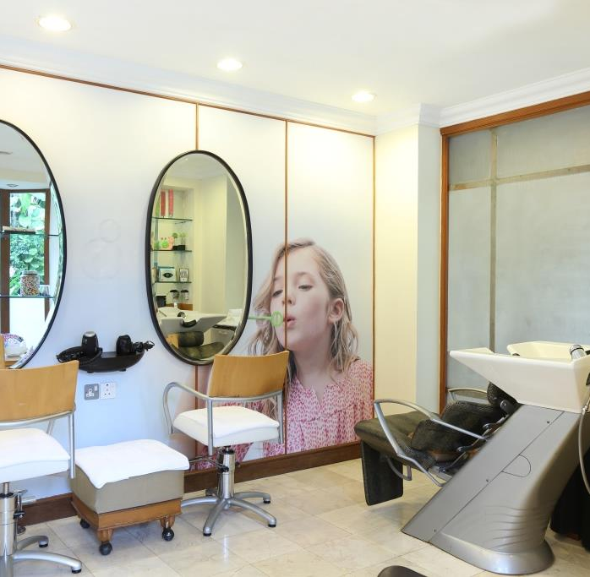
Westin Kids Spa
Young spa-goers will love Westin Kids Spa.
Pamper with massages, mini facials, manicures and pedicures and get Bali beach ready with fun braiding too.
Notes:
Just 1 slide
21

Slide 22
Stay Longer
Stretch out your stay with Westin Weekend, featuring extended breakfast hours and late Sunday checkout.

Slide 23
2017 Awards
Best Indonesia Leading Family Resort by Indonesia Travel Tourism Awards 2017/2018
Best Luxury Family Beach Resort, Country winner by 2017 World Luxury Hotel Awards
Best Luxury Family Hotel, Regional winner by 2017 World Luxury Hotel Awards
Best Luxury Hotel & Conference Centre, Regional winner by 2017 World Luxury Hotel Awards
Listed #1 on Top 10 Family Resorts in Bali by Holiday with Kids Reader’s Choice 2017
Luxury Wellness Spa, 2017 Global Winner by World Luxury Spa Awards
Luxury Family Restaurant for Prego, 2017 Regional Winner by World Luxury Restaurant Awards
Best Italian Restaurant for Prego (1st runner up) by Now!Bali’s Best Restaurant, Bar & Café Awards 2017
Best Spanish Restaurant for Velada Tapas Bar & Kitchen (2nd runner up) by Now!Bali’s Best Restaurant, Bar & Café Awards 2017
Best Japanese Restaurant for Hamabe (2nd runner up) by Now!Bali’s Best Restaurant, Bar & Café Awards 2017
Best Conference Hotels, Best in Travel 2017 by Smart Travel Asia
Best Large Hotel, 2017 International Hotel Awards
International Five Star Standard, 2017 International Hotel Awards
2017 Certificate of Excellence by TripAdvisor

Slide 24
Contacts
^{www.westin.com/bali} Reservation.00035@westin.com

