Slide 1
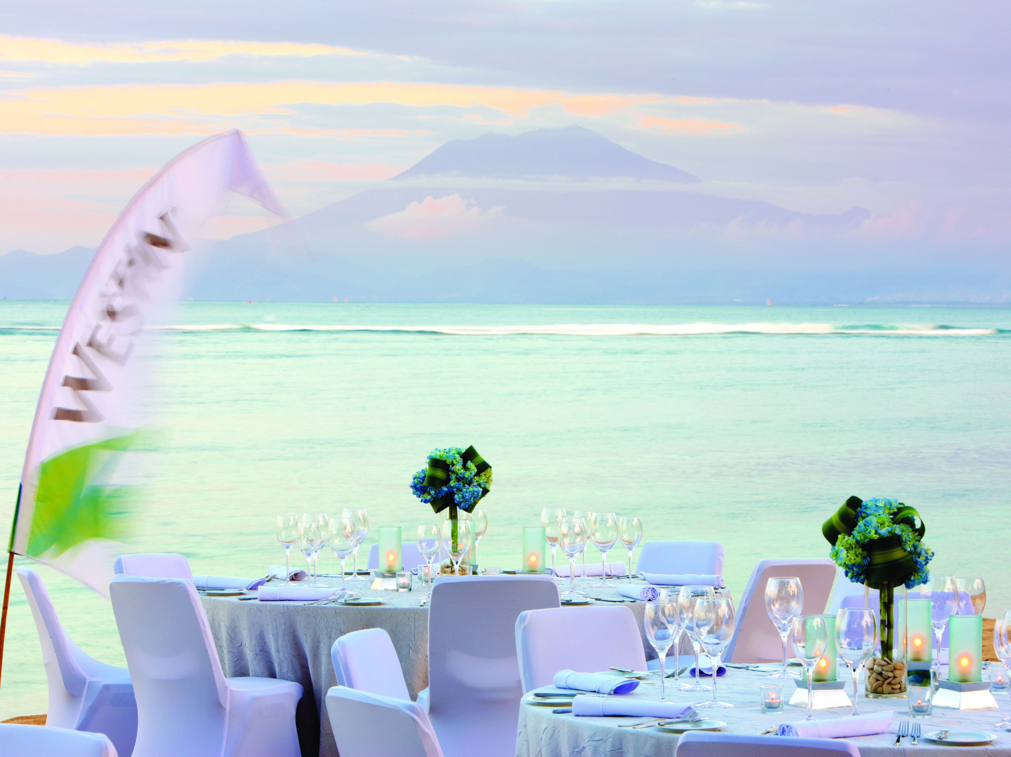
The Westin Resort Nusa Dua, Bali &
Bali International Convention Centre
Bali, Indonesia
©2018 Marriott International, Inc. All Rights Reserved. For internal use only. CONFIDENTIAL & PROPRIETARY – May not be reproduced, disclosed or distributed without the express written permission of Marriott International, Inc.

Slide 2
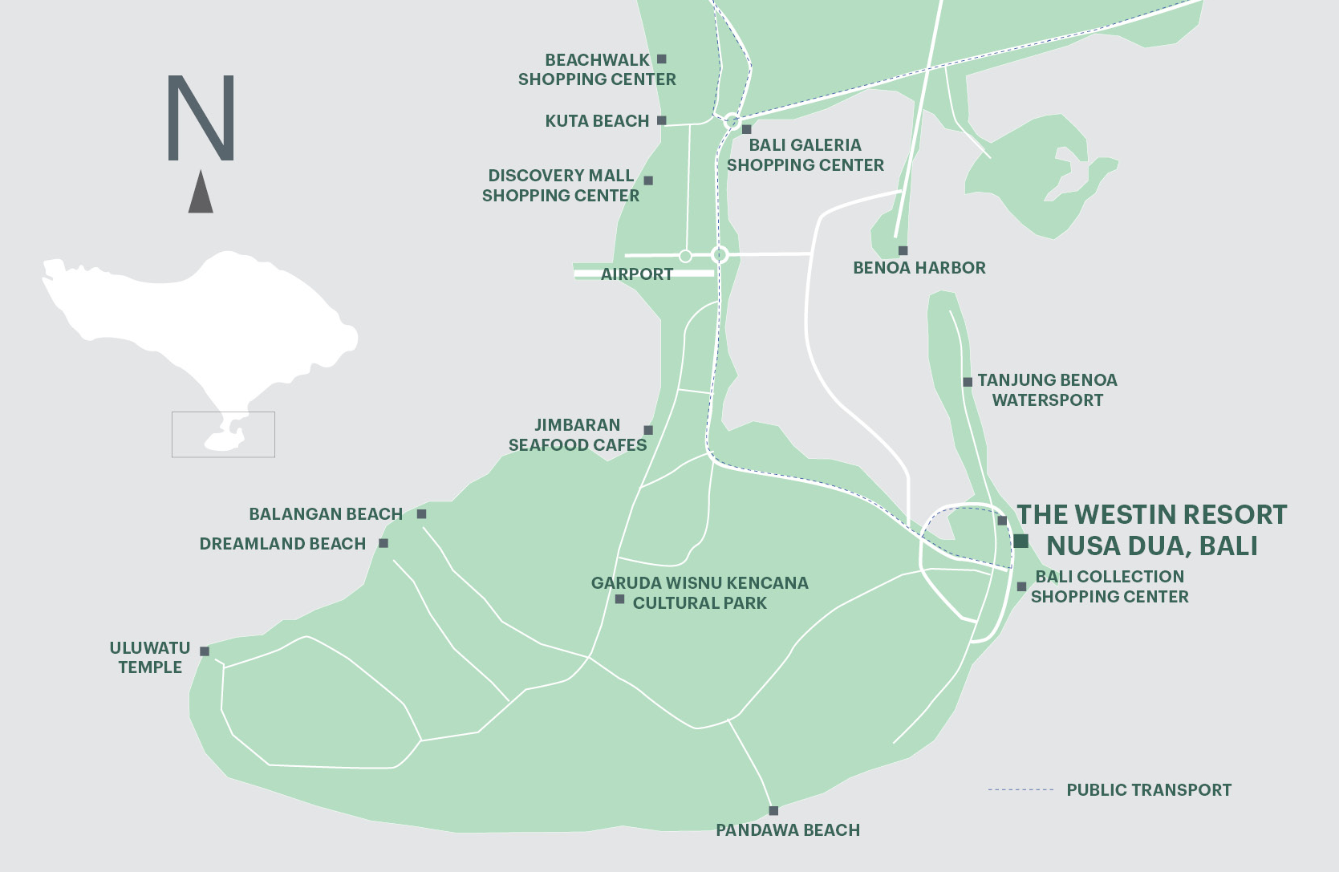
Location

Slide 3
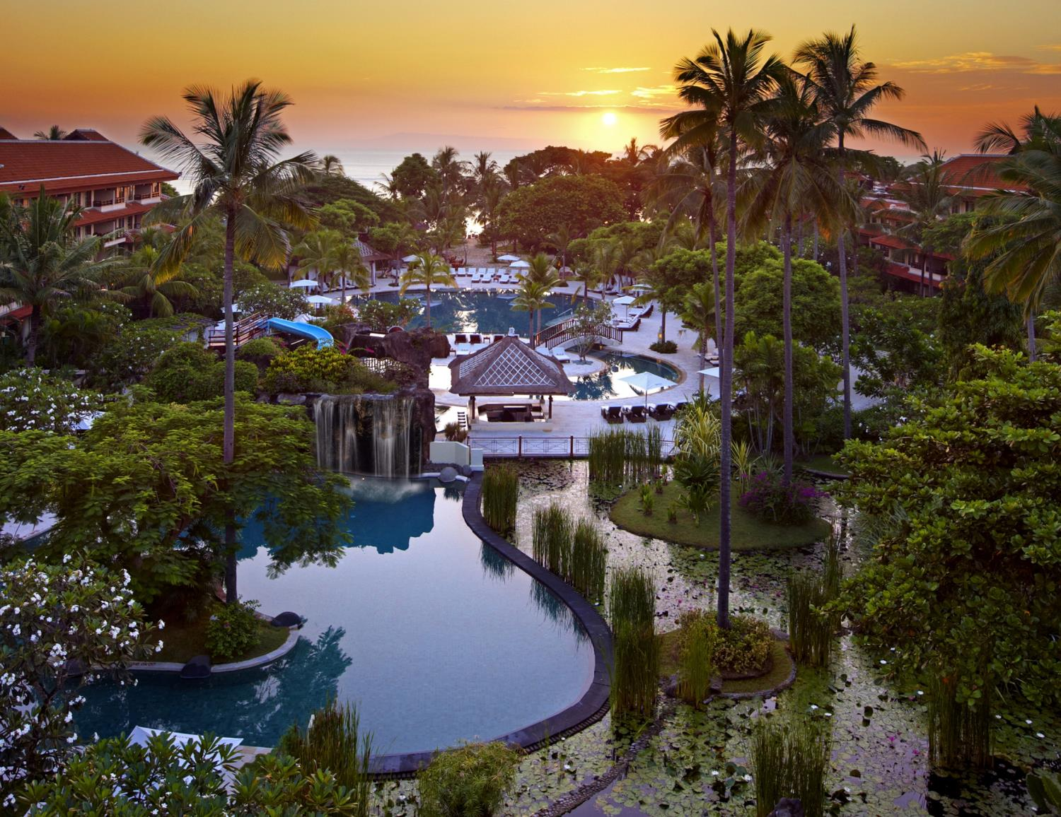
SUNRISE AT THE WESTIN RESORT NUSA DUA, BALI

Slide 4
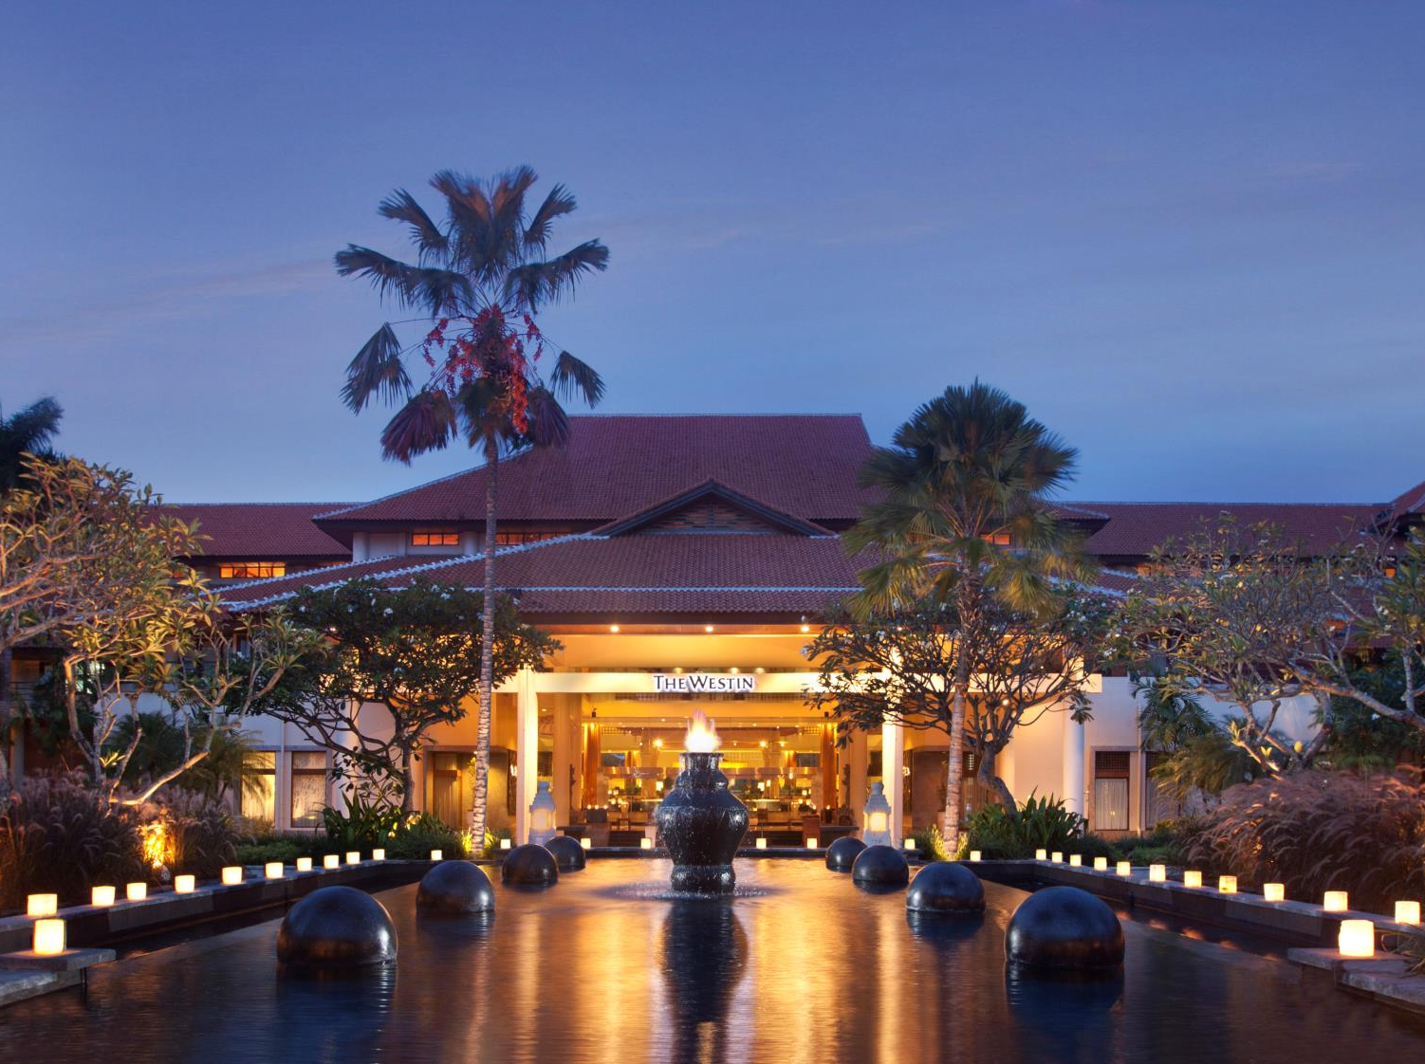
RESORT FACADE

Slide 5
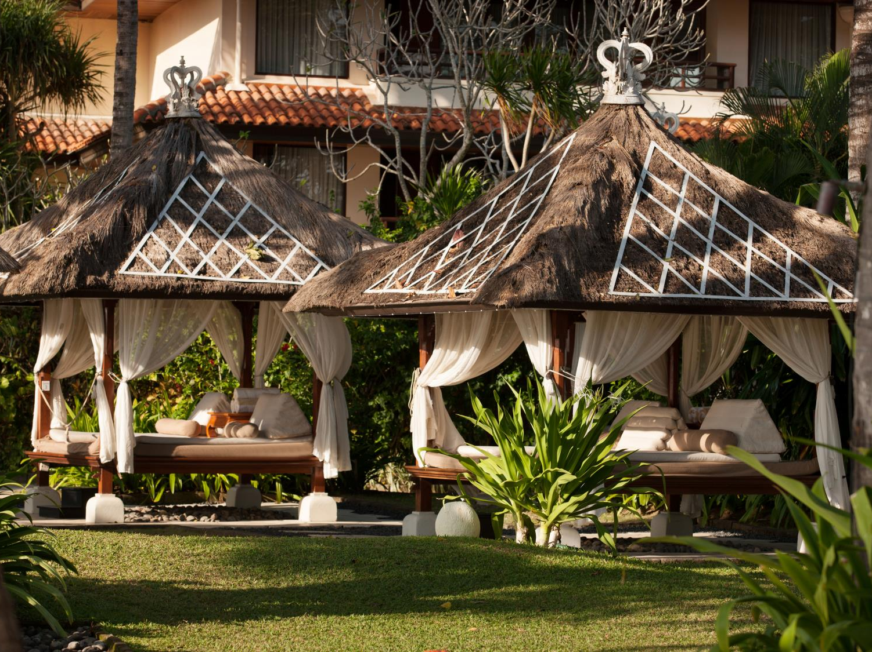
SPA BALE AT BEACHFRONT

Slide 6
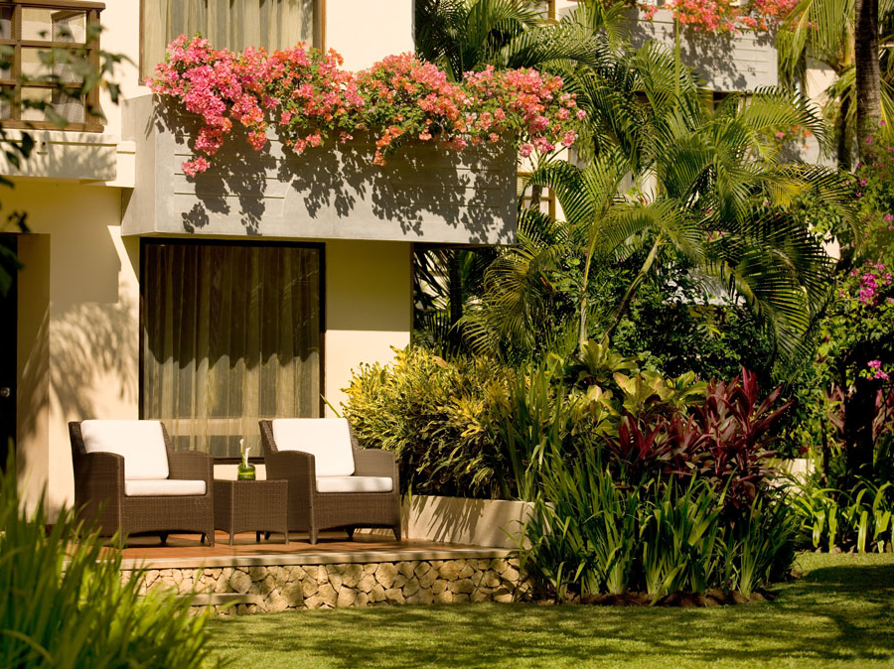
TERRACE WITH TROPICAL GARDEN

Slide 7
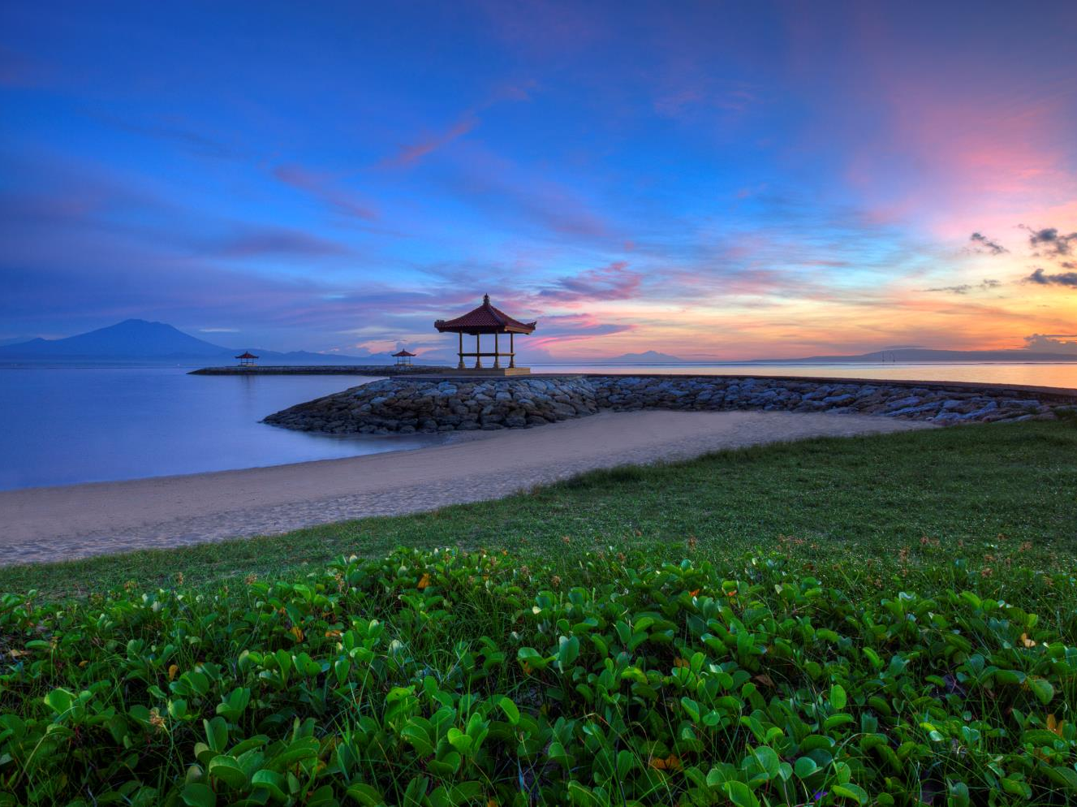
SUNRISE AT NUSA DUA BEACH, BALI

Slide 8
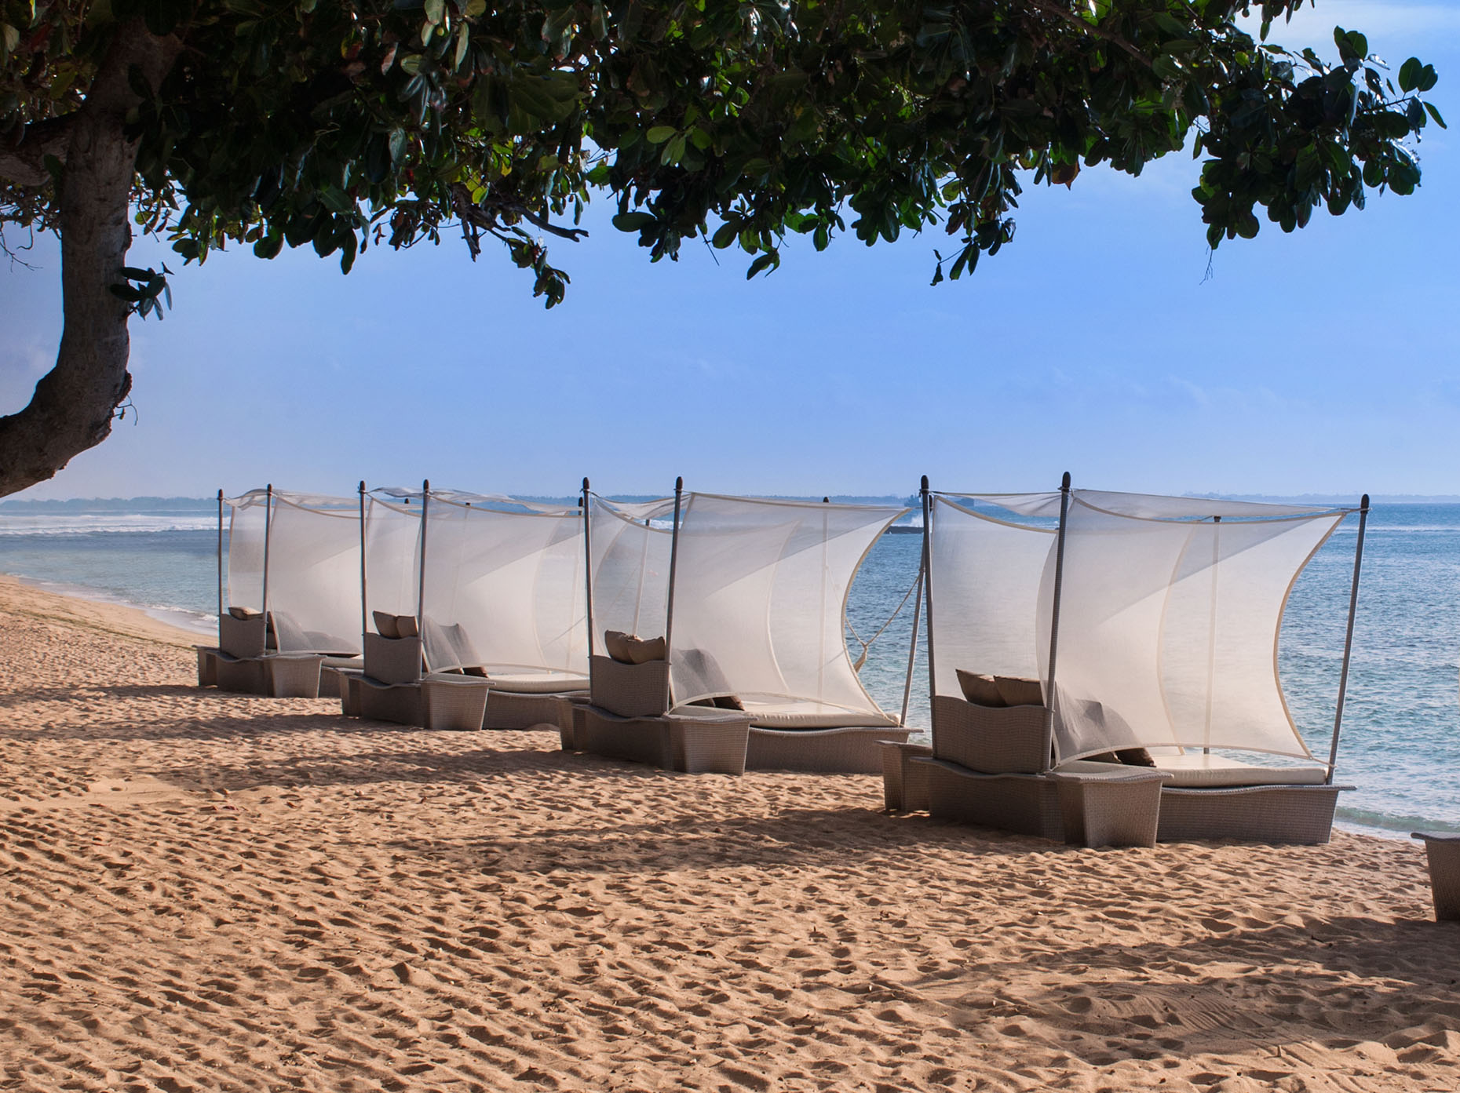
NUSA DUA BEACH, BALI

Slide 9
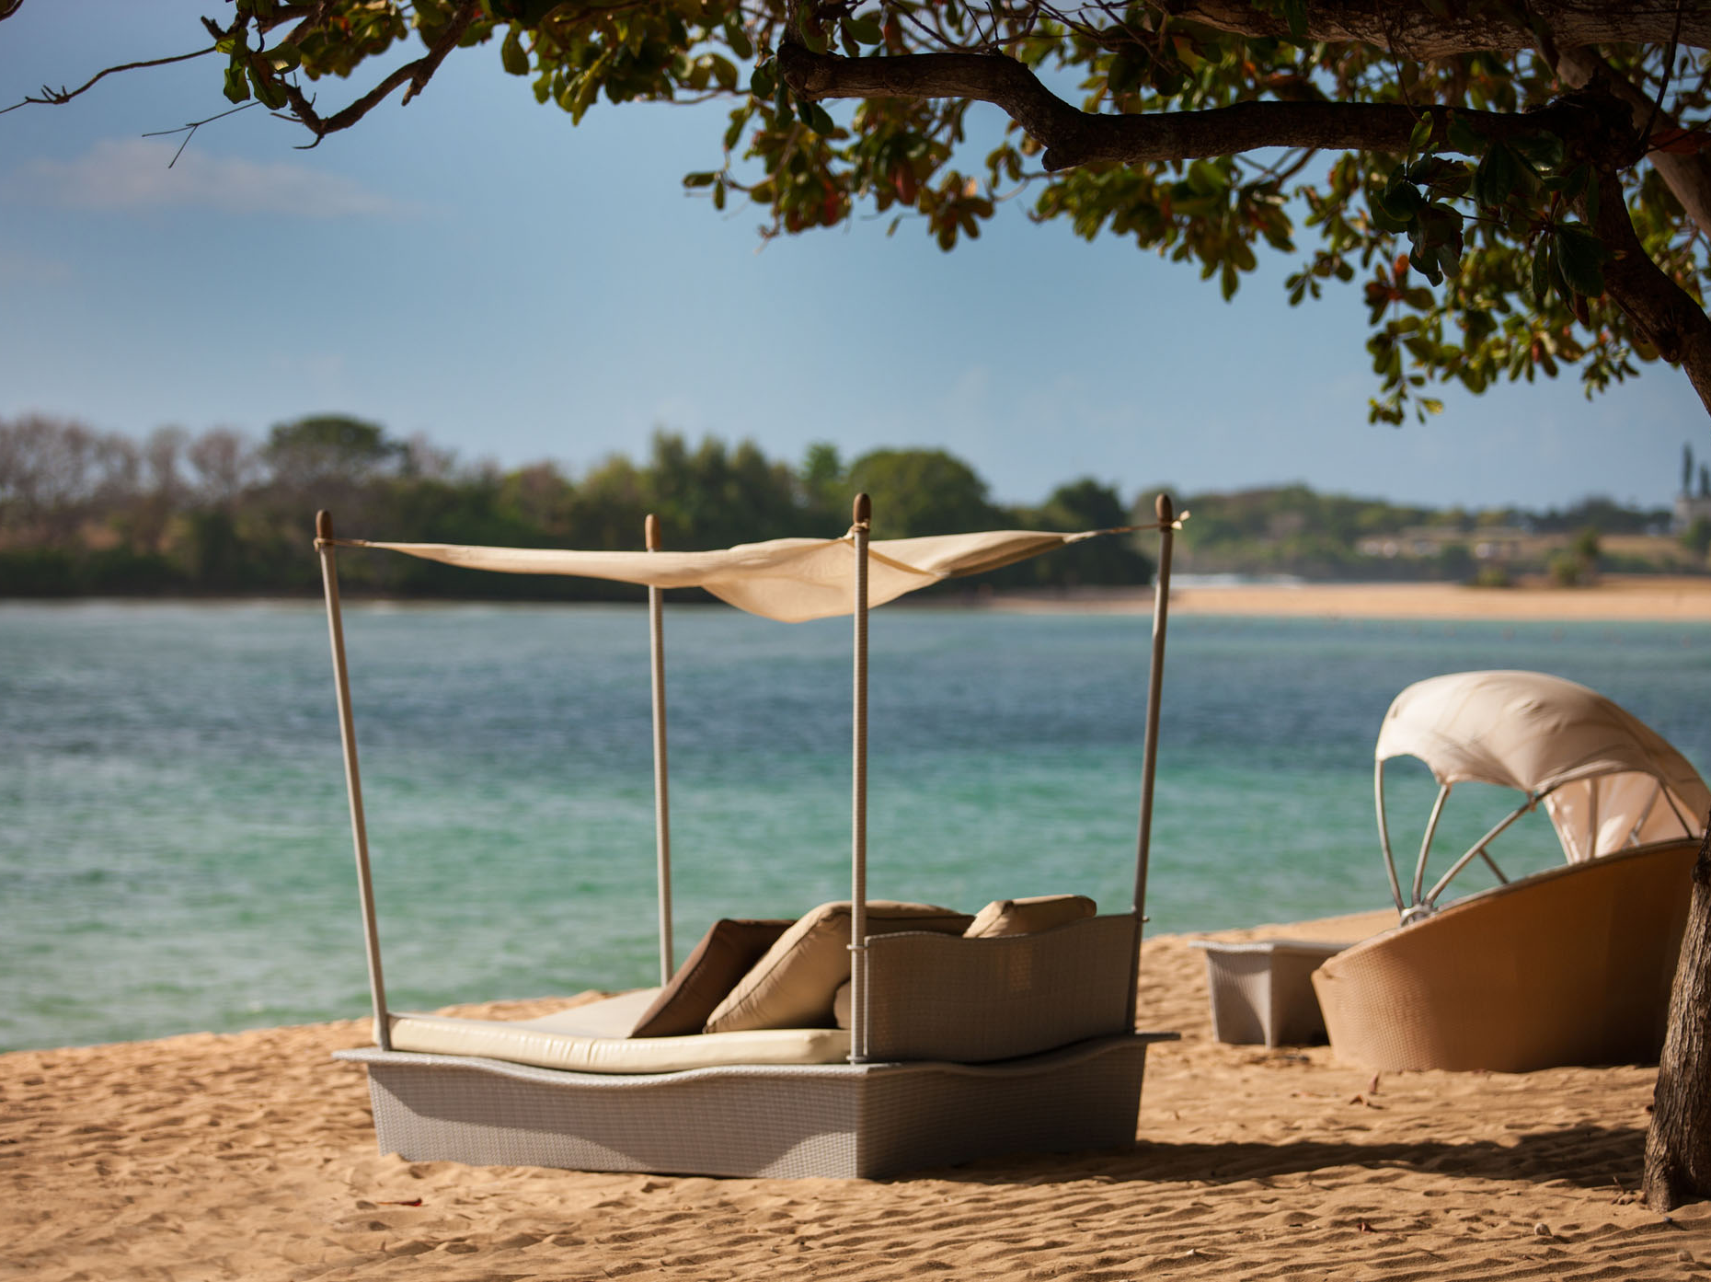
NUSA DUA BEACH, BALI

Slide 10
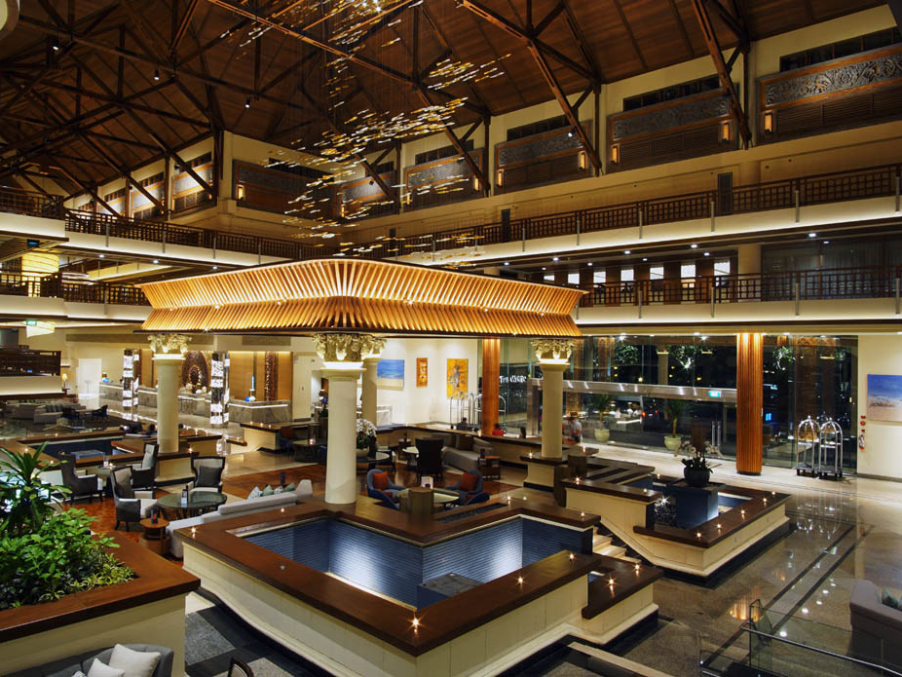
LOBBY

Slide 11
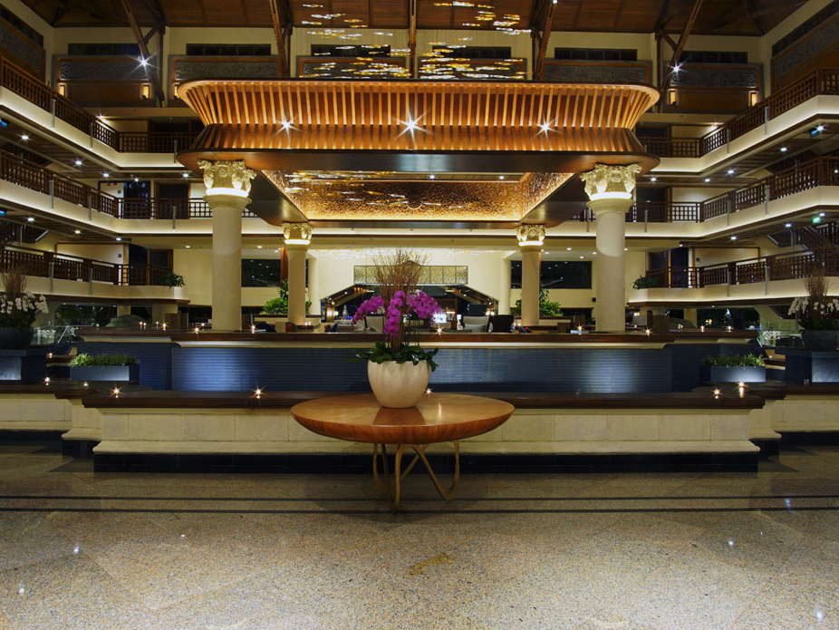
LOBBY

Slide 12
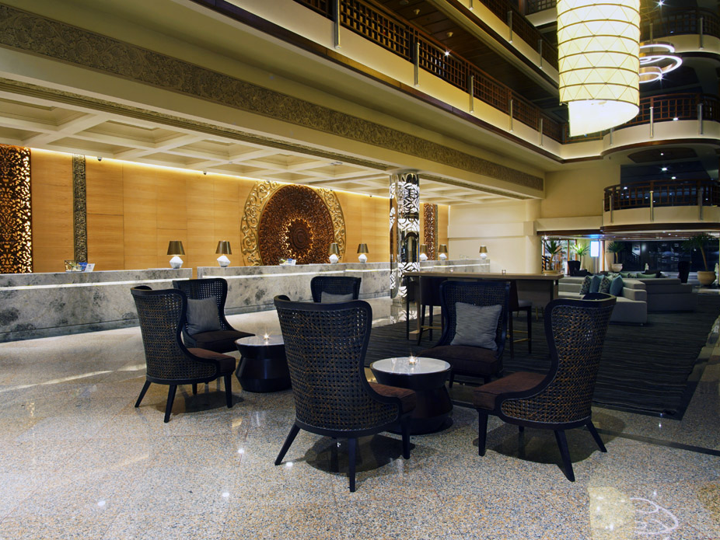
LOBBY

Slide 13
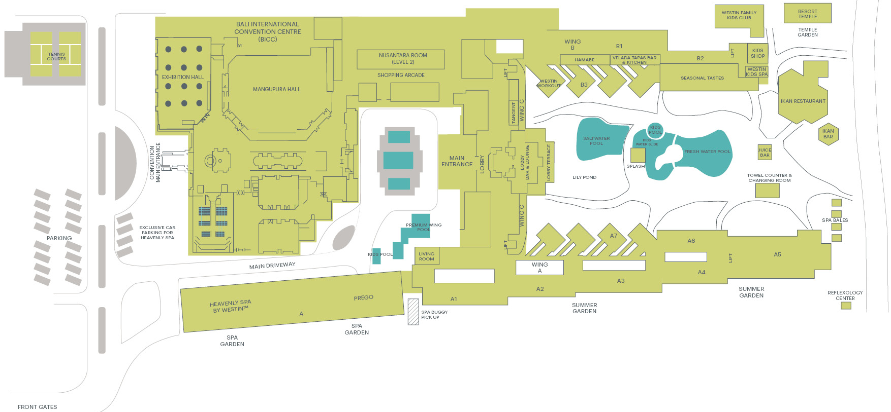
Resort Map

Slide 14
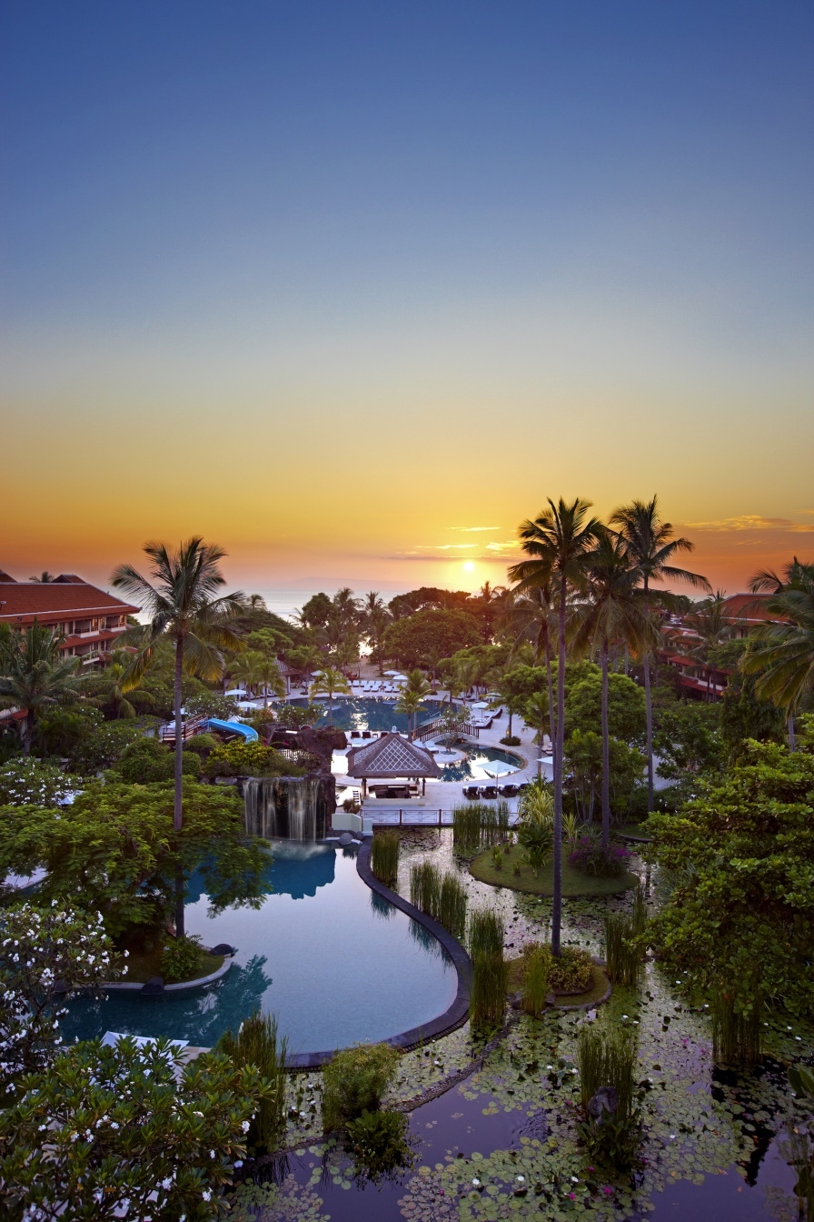
Guest Rooms & Suites
Our exclusive beach resort in Bali features 433 modern luxury rooms. The contemporary guestrooms were designed with touches of nature and traditional Balinese accents reflecting its local surroundings and maintaining its tropical edge. The design emphasizes the beauty and harmony of the space and easily earns its place among the most talked about family resorts in Bali. Guest rooms average 38 sq. meters in size and all rooms and suites are spaciously appointed with ocean, pool or garden views.

Slide 15
Room categories ROH and suites
ROOM TYPE | AREA (SQM) | NUMBER OF ROOMS
DELUXE GARDEN | 38 | 165
DELUXE POOL | 38 | 59
PREMIUM ROOM | 48 | 48
PREMIUM ROOM GARDEN VIEW | 48 | 48
DELUXE GARDEN TERRACE | 38 | 36
DELUXE POOL TERRACE | 38 | 12
EXECUTIVE SUITE | 76 | 4
FAMILY SUITE | 117 | 30
FAMILY SUITE POOL TERRACE | 117 | 4
WESTIN SUITE | 76 | 12
2-BEDROOM OCEAN VIEW SUITE | 86 | 3
2-BEDROOM WESTIN SUITE | 86 | 2
OCEAN VIEW SUITE WITH POOL | 88 | 2
OCEAN VIEW SUITE | 88 | 4
2-BEDROOM RESIDENCE SUITE | 114 | 3
PRESIDENTIAL SUITE | 172 | 1
 |  | TOTAL 433

Slide 16
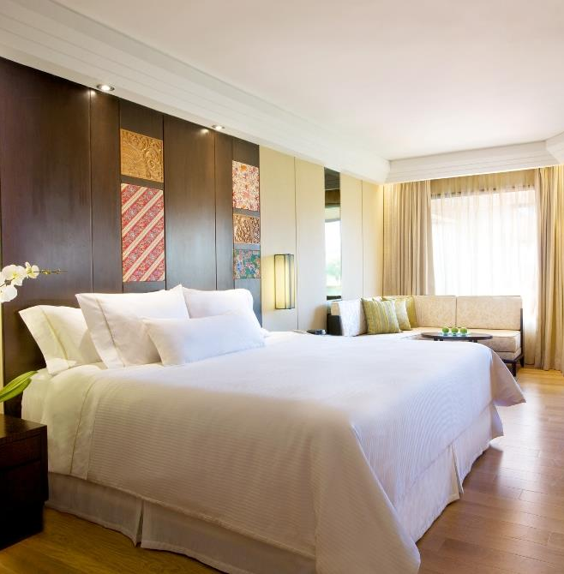
Deluxe Room
Modern in all the best ways, the Deluxe Room at our luxurious Bali family resort combines a contemporary décor with local accents to create a restful ambience. Bathed in natural sunlight, this room goes above and beyond standard Nusa Dua accommodation to encourage renewal thanks to our signature Heavenly® Bed and design-driven bathroom. Selected Deluxe Rooms offer spacious terraces with direct pool or garden access. (409 Square Feet / 38 Square Meters).

Slide 17
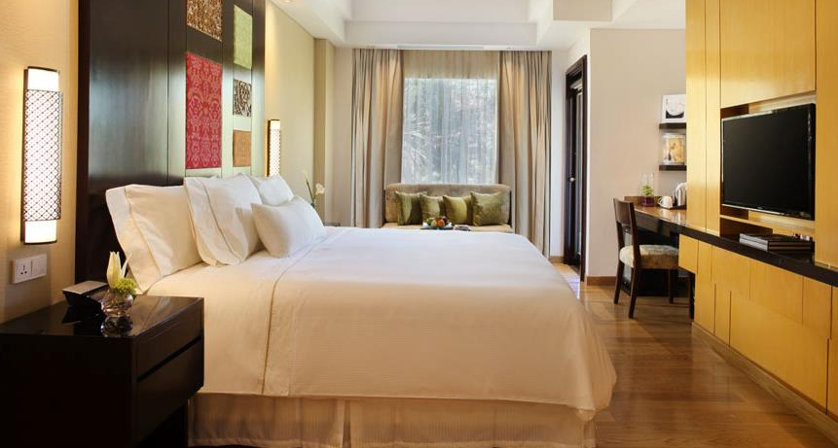
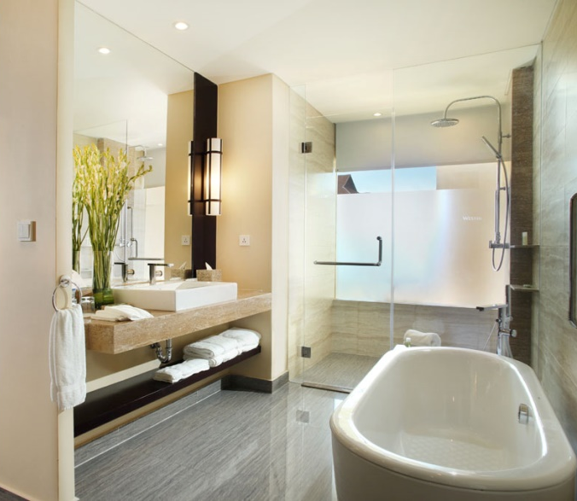
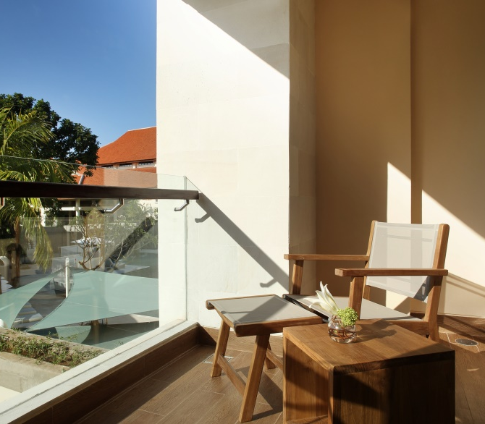
Premium Room
The Premium Room has a glass-front balcony to ensure calming views of the resort’s surroundings. Inside, contemporary design by FBEYE International is distinguished by natural touches and Balinese artwork. A marble-topped workstation is fully wired to help you stay connected at all times. A flat screen TV and a refreshment center facilitate relaxing downtime at our Bali Nusa Dua hotel. This room also includes a design-driven bathroom and ample wardrobe space. (517 Square Feet / 48 Square Meters)

Slide 18
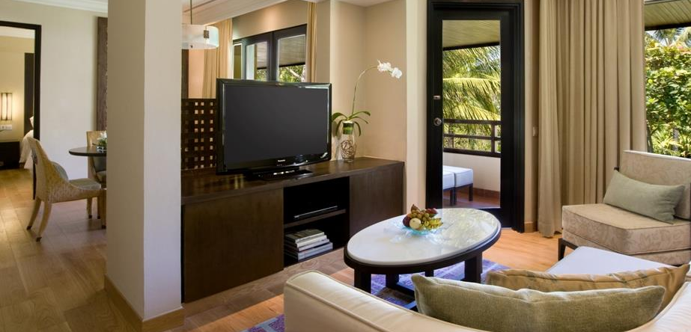
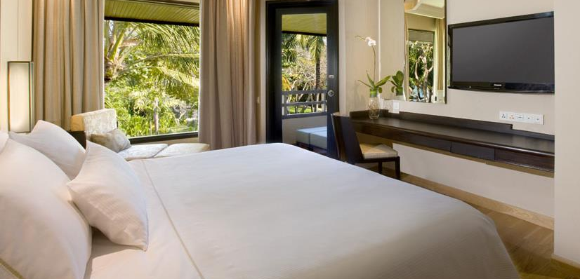
One-Bedroom Suite
This luxury category covers both the Executive Suite and Westin Suite. Each suite provides plenty of space to ensure your privacy and relaxation. Enjoy garden or pool views from a large balcony, complete with uniquely designed living and dining areas. A separate bedroom with the latest Westin Heavenly Bed® guarantees a good night’s sleep. These attributes have helped us achieve our award-winning status as one of the best family resorts Bali. (818 Square Feet / 76 Square Meters)

Slide 19
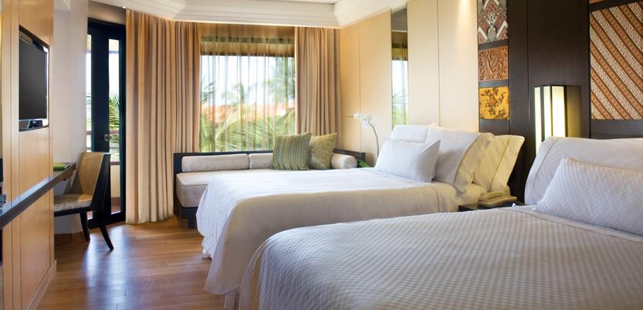
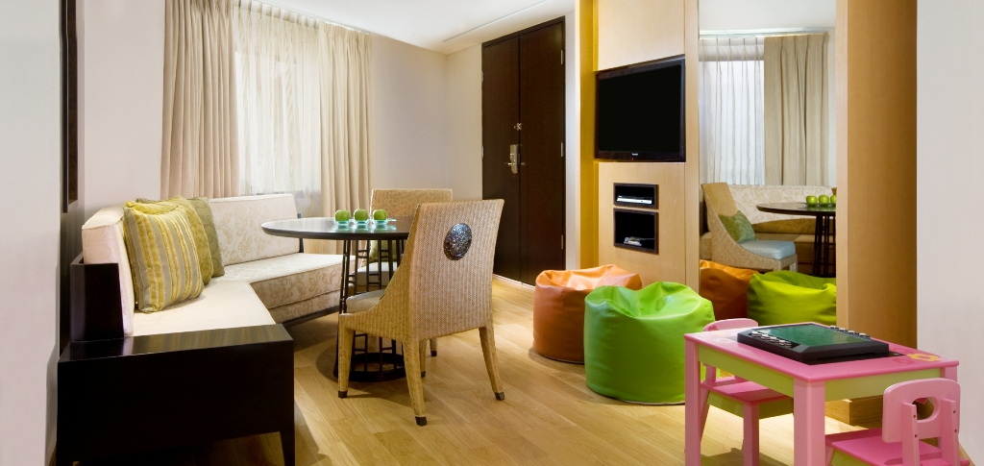
Family Suite
Our expansive Family Suite is designed to make traveling with kids a whole lot easier. This Bali family accommodation category comes with two private bedrooms and a separate living area. There’s plenty of space for everyone to relax and recharge after a fun day out in the tropics. The suite even features assorted board games to keep youngsters entertained for hours. A daybed in the kid’s room is large enough to sleep an adult. (1,259 Square Feet / 117 Square Meters)

Slide 20
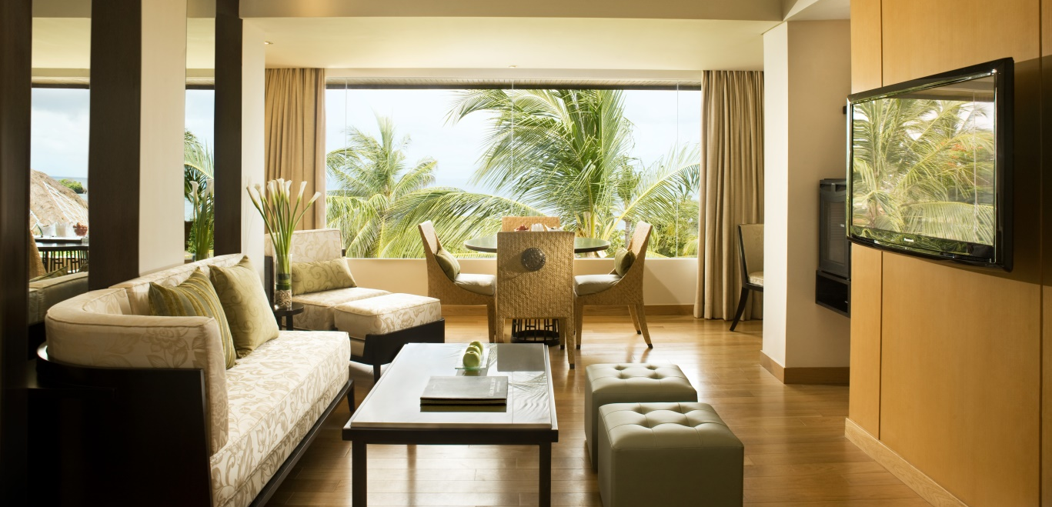
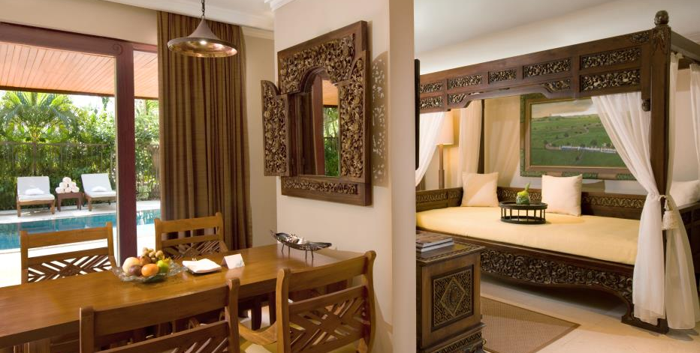
Ocean View Suite
For a revitalizing Bali beach resort experience, maximize your downtime in a spacious Ocean View Suite. It comes complete with an inviting living room and dining area, as well as an oversized balcony or private pool that takes in the natural beauty of the Indian Ocean. This category promises in-room indulgence that is quite unique to our Nusa Dua hotel. Meanwhile, the separate bedroom with its signature Heavenly Bed® guarantees a rejuvenating night’s sleep. (926 Square Feet / 86 Square Meters)

Slide 21
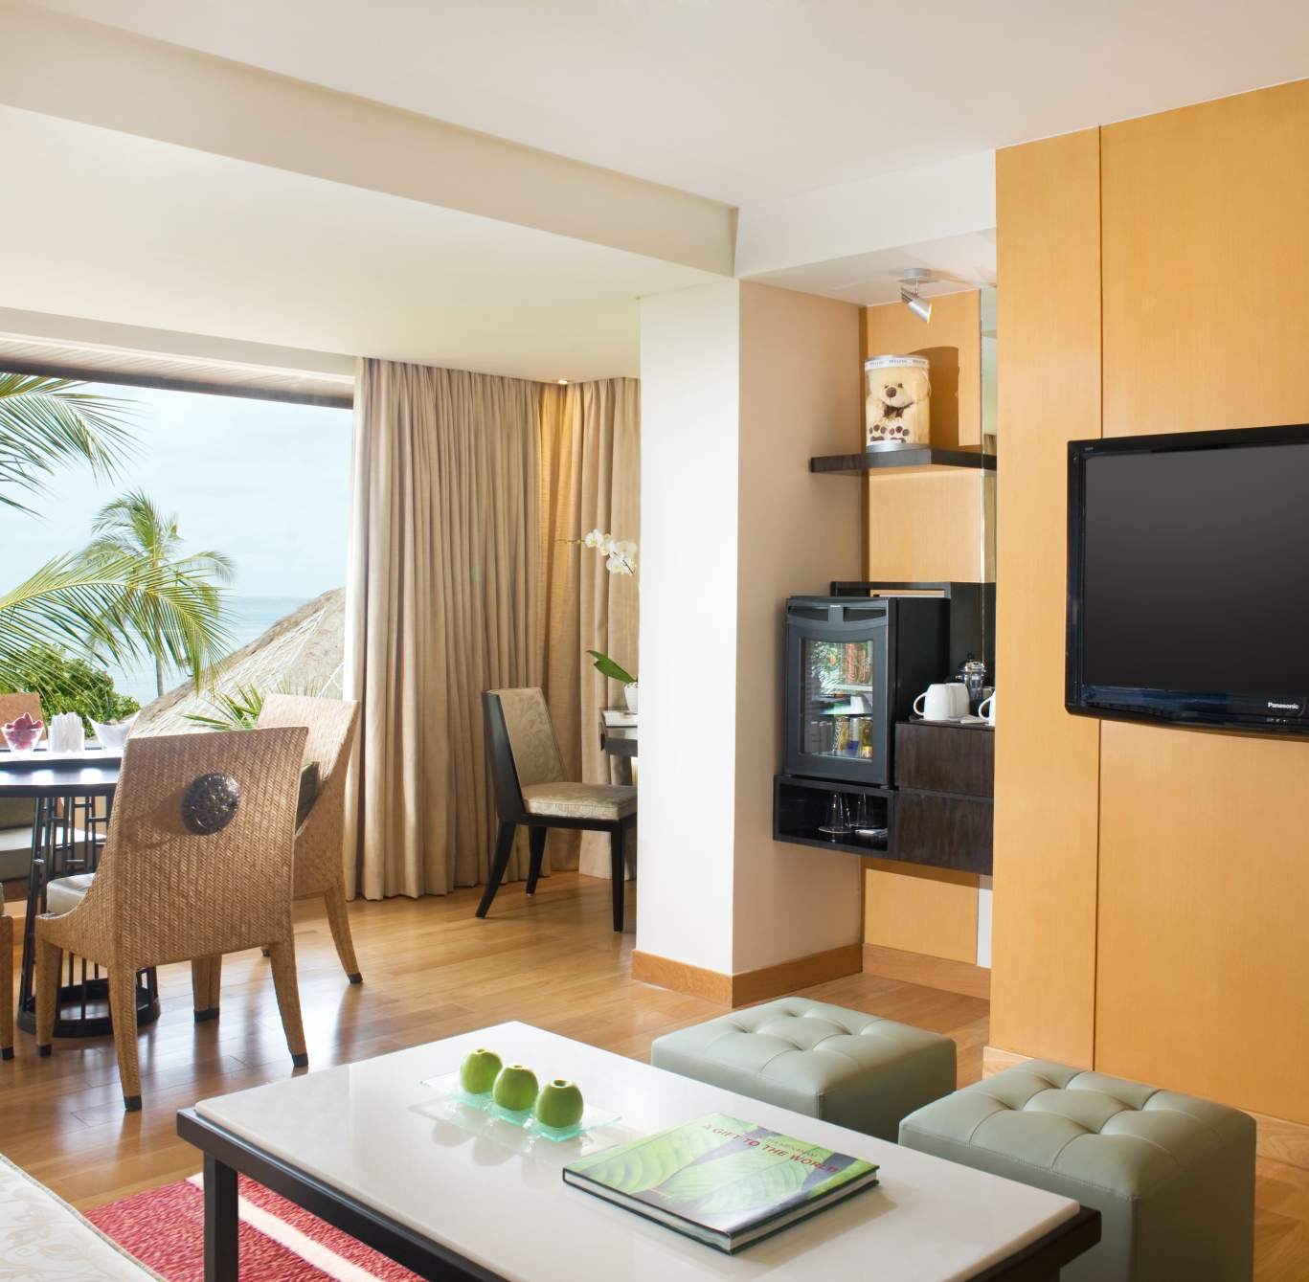
Two-Bedroom Suite
Whether you are traveling with teenage children or adult friends, the Two-Bedroom Suite offered by our Nusa Dua resort is an ideal choice to be connected and still maintain your privacy. Gather in the expansive living room where there is space for everyone to unwind. Both bedrooms have a refreshing décor with a Heavenly Bed® and design-driven bathroom for essential relaxation. Each luxury suite category offers either Indian Ocean or garden views..
2-Bedroom Ocean View Suite –
86 square meters
2-bedroom Residence Suite –
144 square meters
2-Bedroom Presidential Suite - 117 square meters

Slide 22
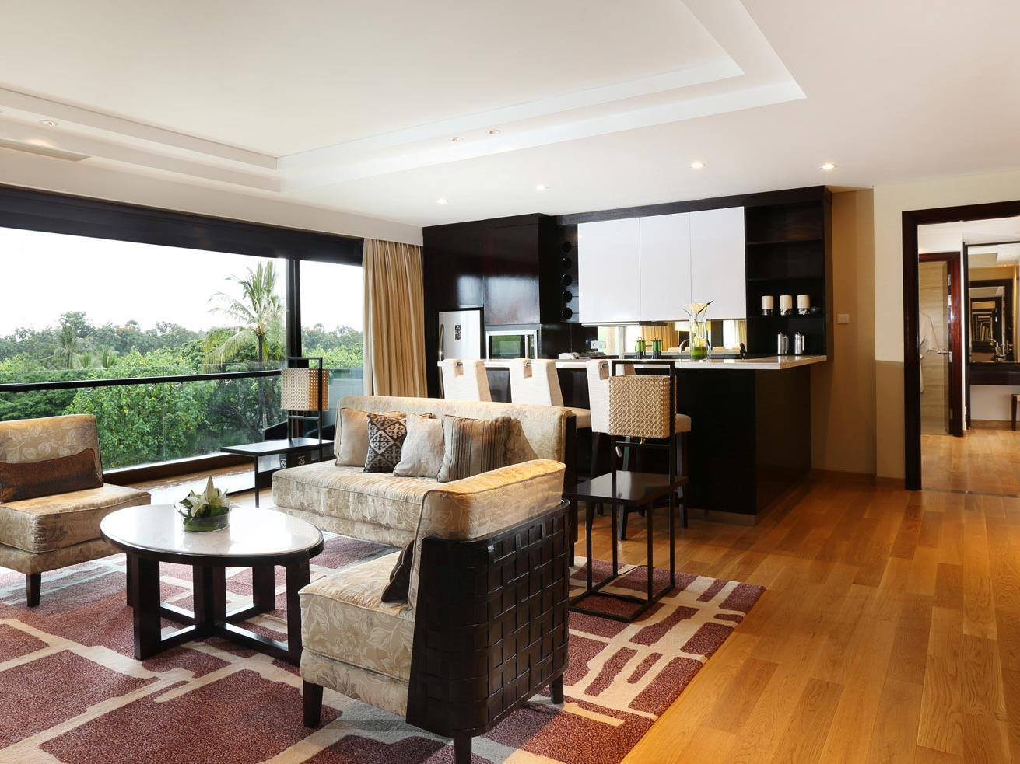
2-BEDROOM RESIDENCE SUITE – Living Room
©2015 Starwood Hotels & Resorts Worldwide, Inc. All Rights Reserved. For internal use only. CONFIDENTIAL & PROPRIETARY – May not be reproduced, disclosed or distributed without the express written permission of Starwood Hotels & Resorts Worldwide, Inc.

Slide 23
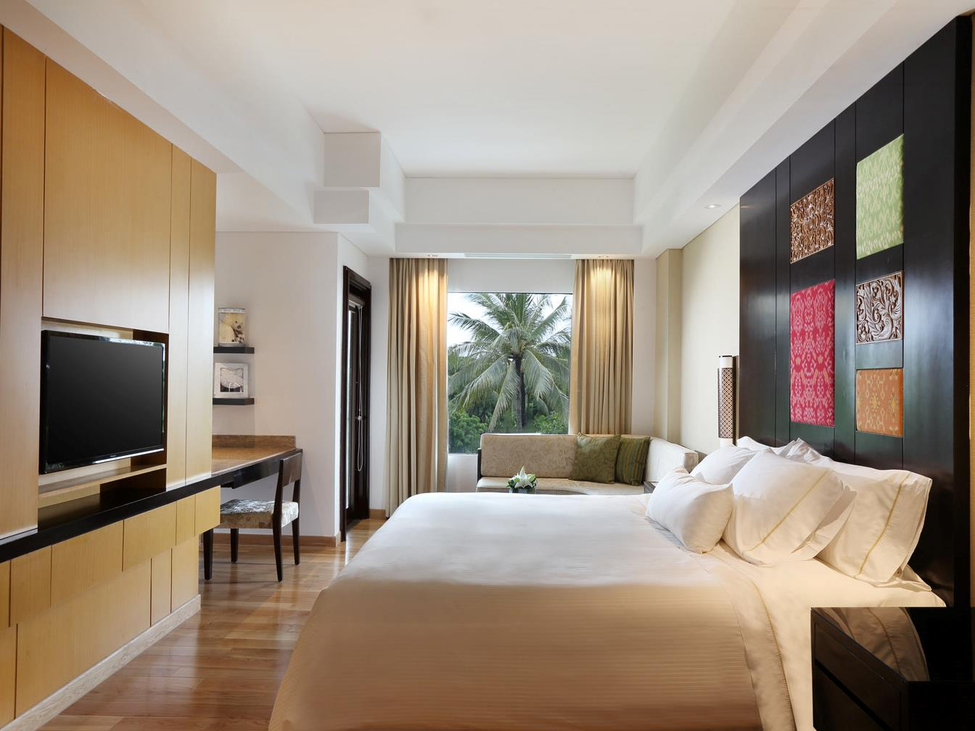
2-BEDROOM RESIDENCE SUITE
©2015 Starwood Hotels & Resorts Worldwide, Inc. All Rights Reserved. For internal use only. CONFIDENTIAL & PROPRIETARY – May not be reproduced, disclosed or distributed without the express written permission of Starwood Hotels & Resorts Worldwide, Inc.

Slide 24
Room categories ROH and suites
ROOM TYPE | AREA (SQM) | NUMBER OF ROOMS
DELUXE GARDEN | 38 | 165
DELUXE POOL | 38 | 59
PREMIUM ROOM | 48 | 48
PREMIUM ROOM GARDEN VIEW | 48 | 48
DELUXE GARDEN TERRACE | 38 | 36
DELUXE POOL TERRACE | 38 | 12
EXECUTIVE SUITE | 76 | 4
FAMILY SUITE | 117 | 30
FAMILY SUITE POOL TERRACE | 117 | 4
WESTIN SUITE | 76 | 12
2-BEDROOM OCEAN VIEW SUITE | 86 | 3
2-BEDROOM WESTIN SUITE | 86 | 2
OCEAN VIEW SUITE WITH POOL | 88 | 2
OCEAN VIEW SUITE | 88 | 4
2-BEDROOM RESIDENCE SUITE | 114 | 3
PRESIDENTIAL SUITE | 172 | 1
 |  | TOTAL 433

Slide 25
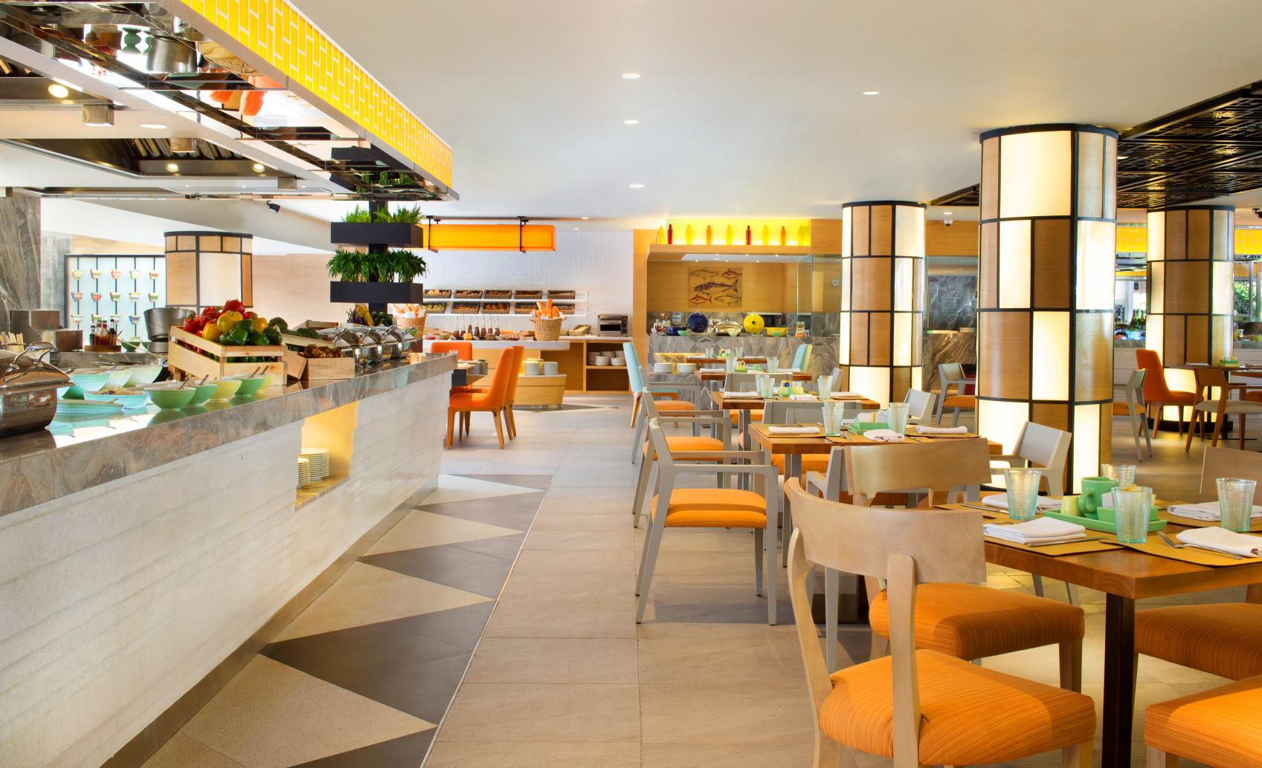
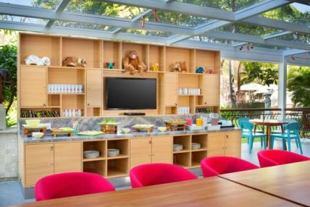
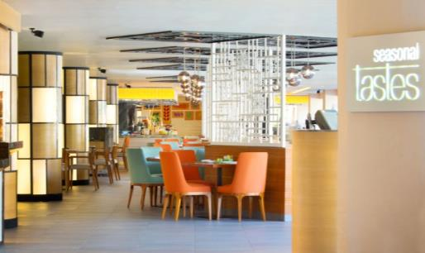
Seasonal Tastes
All Day Dining Restaurant
Our open kitchen concept will truly satisfy your appetite with live cooking stations serving cuisine from around the globe. From the exotic flavors of Asia to healthy fare of the Mediterranean, let us take you on a tempting adventure filled with culinary delights. You are invited to enjoy a unique dining experience in the contemporary ambience of Seasonal Tastes.
Cuisine: Asian specialties, seafood and Western cuisine
Dress code: resort casual
Hours: 6:30AM to 10:30AM
Atmosphere: relaxing casual
Setting: semi al fresco with live cooking stations and kids dining area

Slide 26
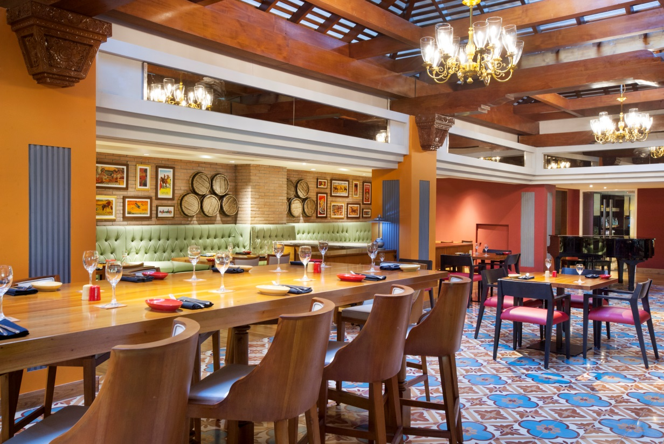
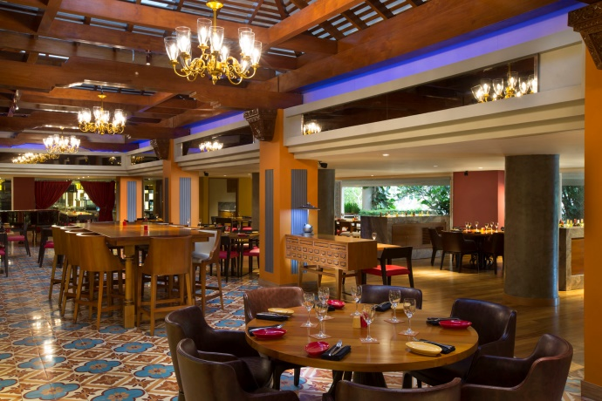
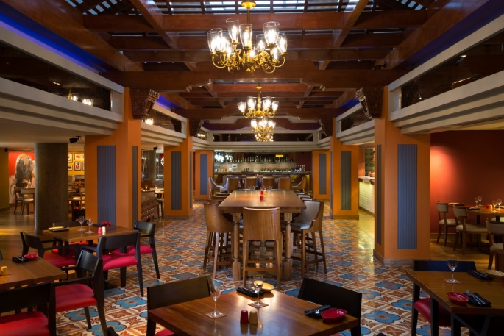
Velada Tapas Bar & Kitchen
Velada is the perfect place to unwind at the end of the day in a vibrant setting over authentic Spanish bites and refreshing cocktails. Get sipping during our Happy Hour and treat yourself to a glass of fruity Sangria or try our signature Margarita to get you in the mood whilst listening to our live Jazz performance.
Cuisine: Spanish tapas
Dress code: resort casual
Hours: 5PM to 12:30AM, 7PM to 9PM (Happy Hours),
Atmosphere: contemporary
Setting: open kitchen and bar with combined seating

Slide 27
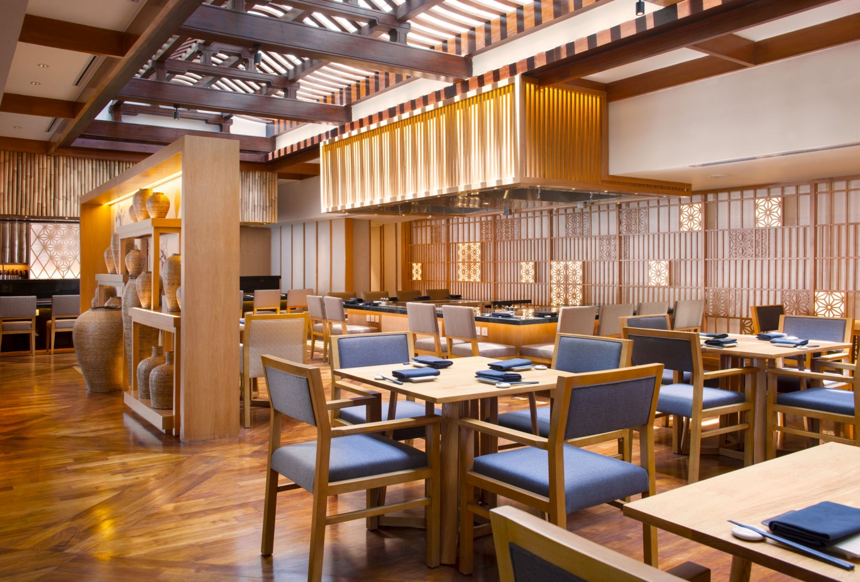
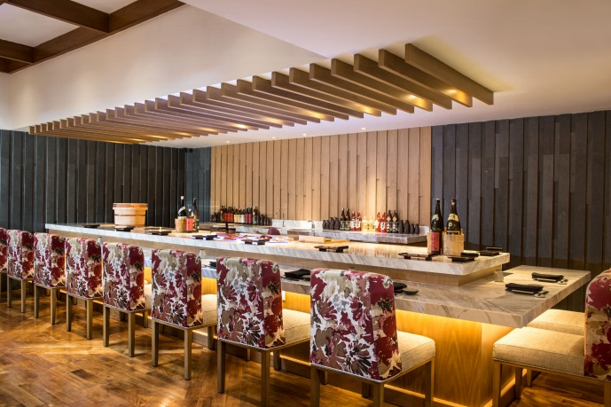
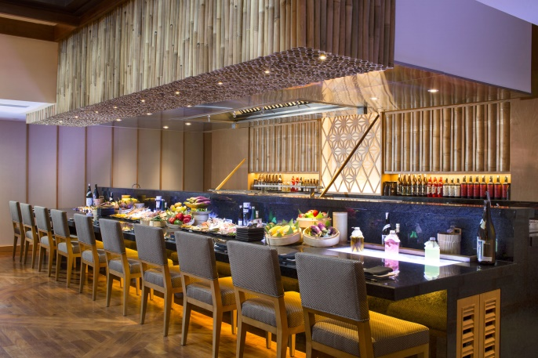
Hamabe
Japanese Restaurant
Hamabe combines modern and authentic Japanese cuisine of the very best quality. It features a robata grill, a traditional cooking method used by the fishermen of northern Japan. Other dining options include a sushi and sashimi counter, as well as teppanyaki tables to enjoy the theatrics of food being cooked before your eyes.
Cuisine: Japanese robata grill
Dress code: resort casual
Hours: 5:30PM to 10PM, 5:30PM to 7PM (family dining), 7PM to 10PM (adult only)
Atmosphere: contemporary
Setting: open kitchen and bar with combined seating

Slide 28
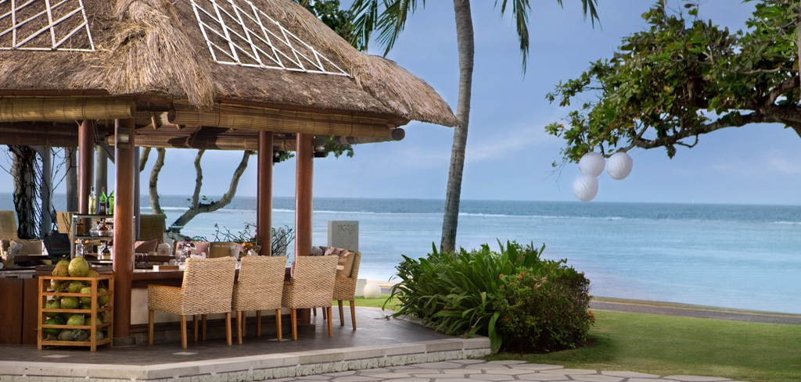
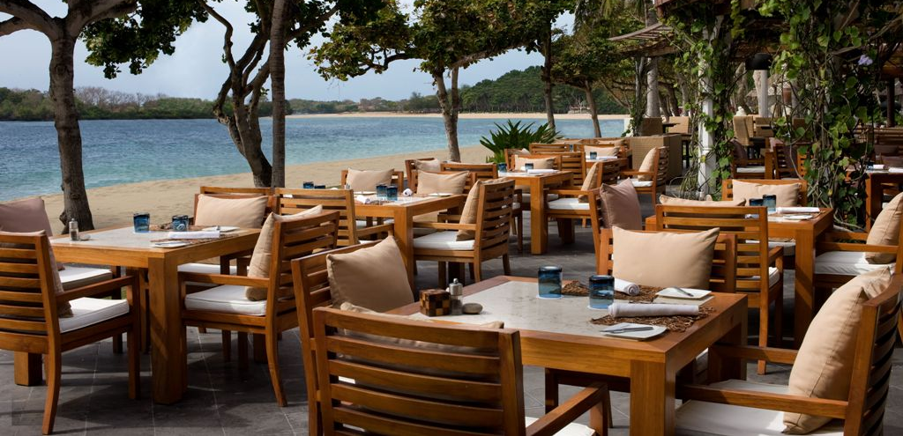
Ikan Beachfront Restaurant & Bar
Just footsteps from the white sand beach of Nusa Dua, Ikan Restaurant looks over the Indian Ocean and promises a relaxed dining ambience. This beach restaurant in Bali serves authentic Balinese specialties, island-fresh seafood, and Western cuisine in an oceanfront setting.
Cuisine: Balinese specialties, seafood and Western cuisine
Dress code: resort casual
Hours: 11AM to 11PM; Bar open daily from 11AM to 1AM
Atmosphere: relaxed beach ambiance
Setting: open air with the Indian Ocean views

Slide 29
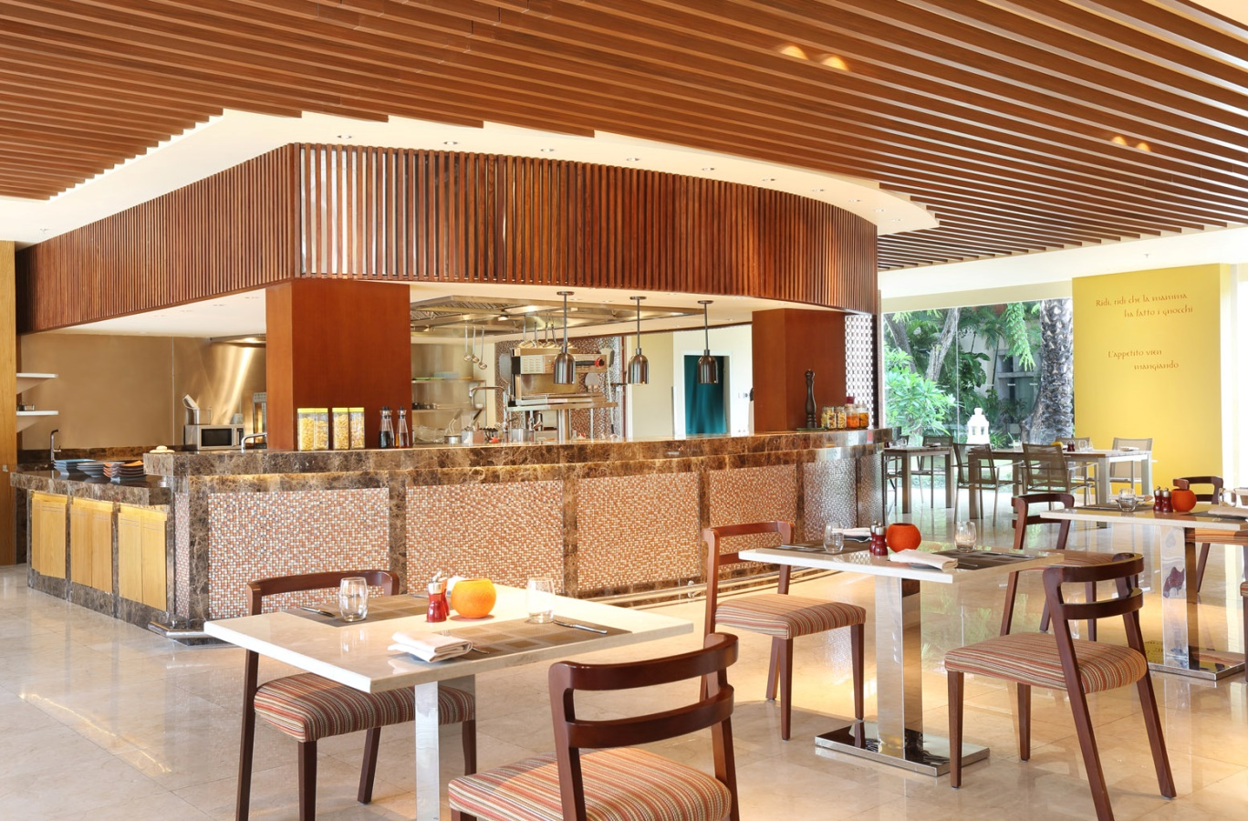
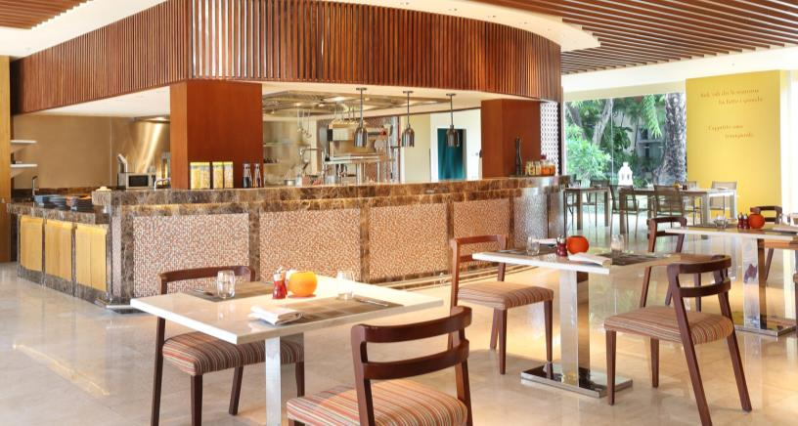
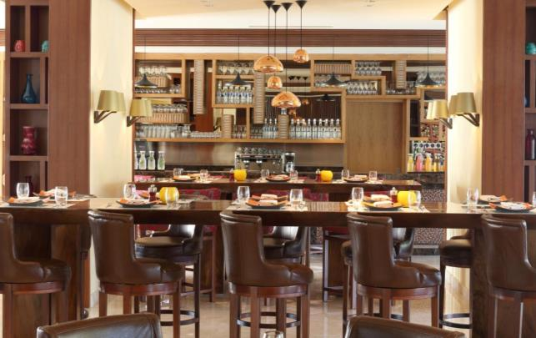
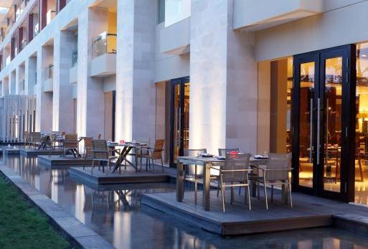
Prego Fun Italian Restaurant
This lively eatery is the perfect place to bring the entire family for a delicious meal of authentic Italian cuisine. It is an inviting space that entices the senses with a colorful décor and the aroma of food being cooked in an open-concept kitchen. Feast on classic pasta dishes, regional favorites and pizzas. Prego’s weekly highlight is FunDay Family Brunch every Sunday.
Cuisine: Italian
Dress code: casual
Hours: 11:30AM to 11PM, 11:30AM to 3PM (FunDay Family Brunch on Sundays)
Atmosphere: upbeat, lively, modern
Setting: colorful décor / open plan kitchen

Slide 30

Award-winning
Heavenly Spa By Westin™
Heavenly Spa by Westin™ offers uplifting spa experiences to restore body and soul at our wellness resort in Bali. Unwind in luxurious his and hers thermal facilities, release muscle tension in the shiatsu room or rejuvenate with sacred spa rituals.
Complimentary with every spa treatment
Arrive 30–45 minutes before your first service, and enjoy the steam room, Himalayan salt-sauna, hydro pool or a warm shower. It’s the perfect way to relax and warm your muscles, aiding the therapeutic benefits of our treatment and services.

Slide 31
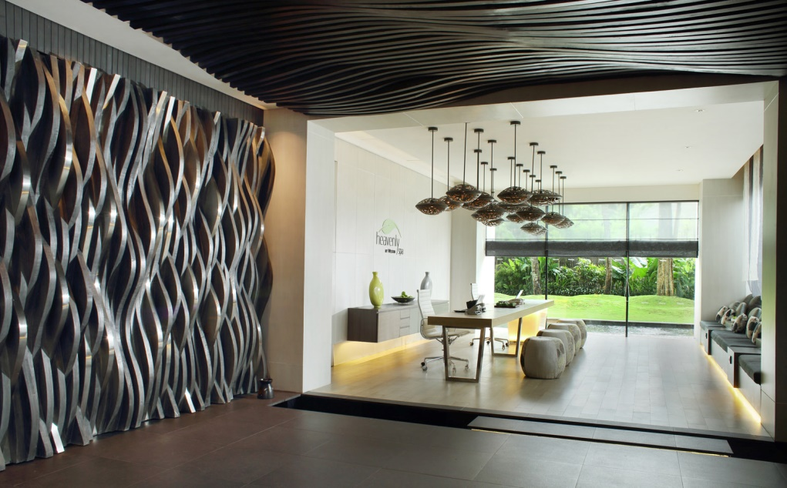
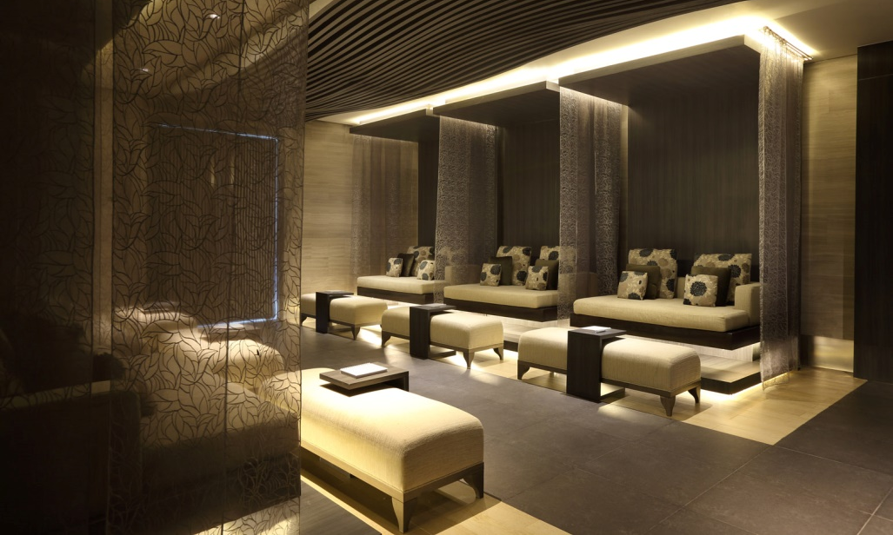
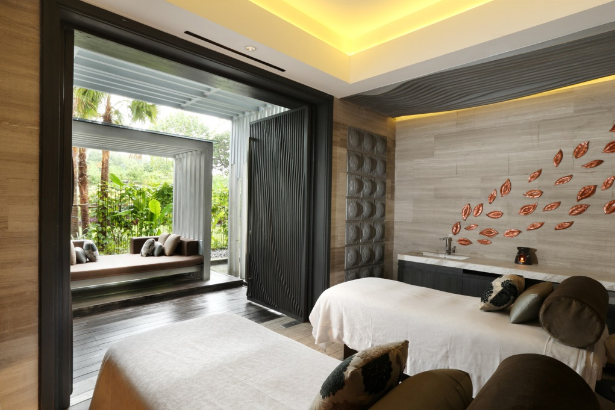
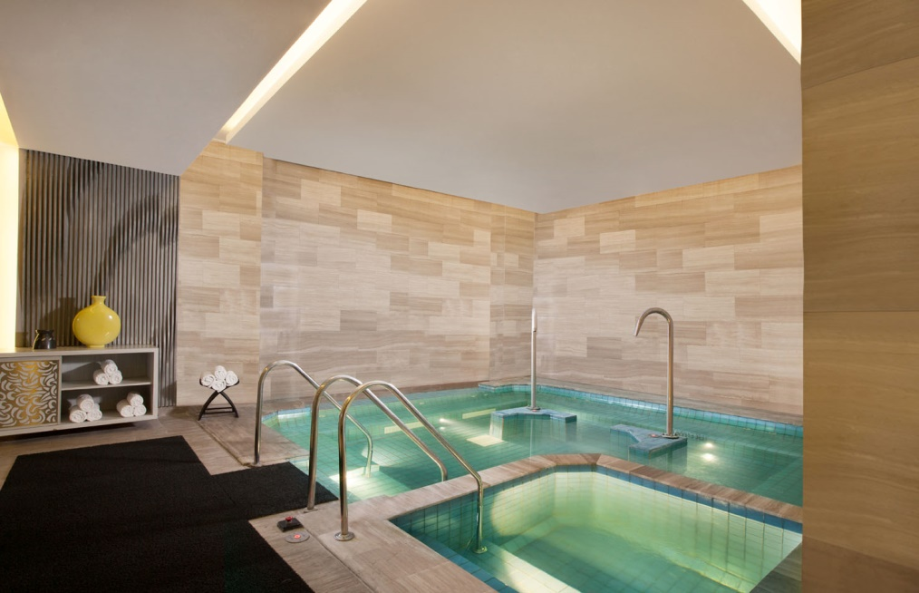
Heavenly Spa Reception
Relaxation Lounge
Double Treatment Room
Thermal Facility

Slide 32
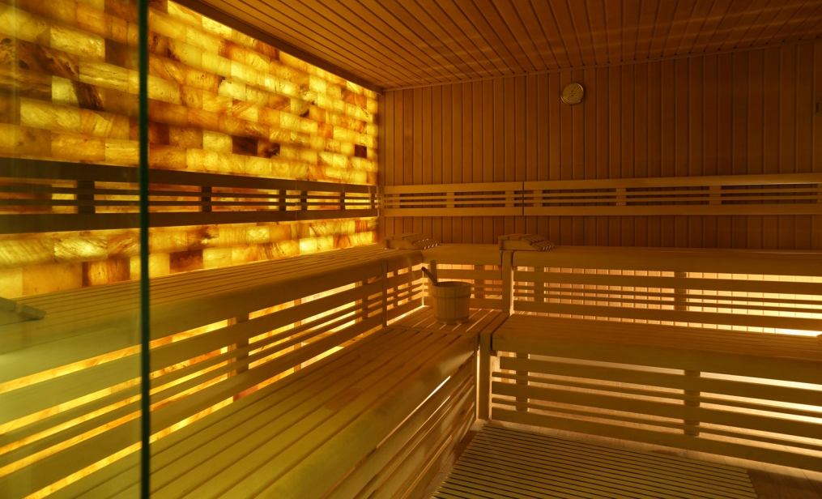
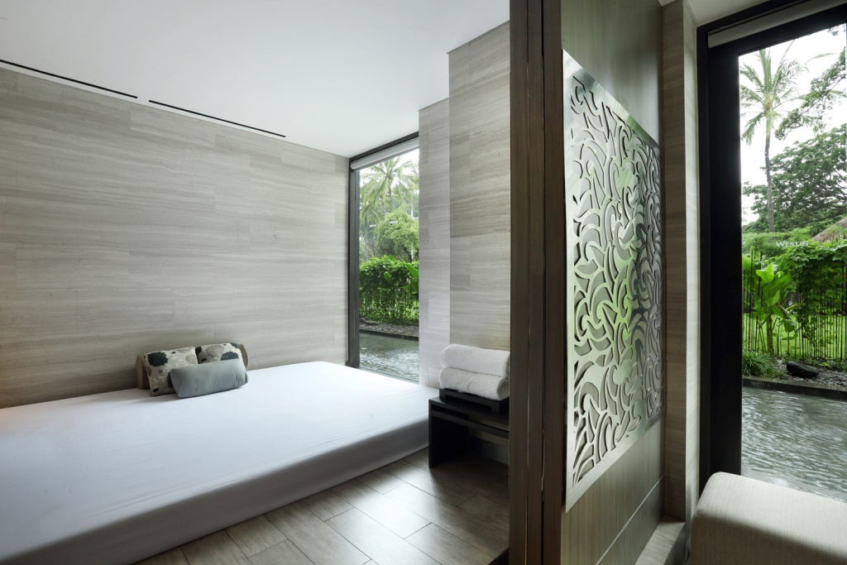
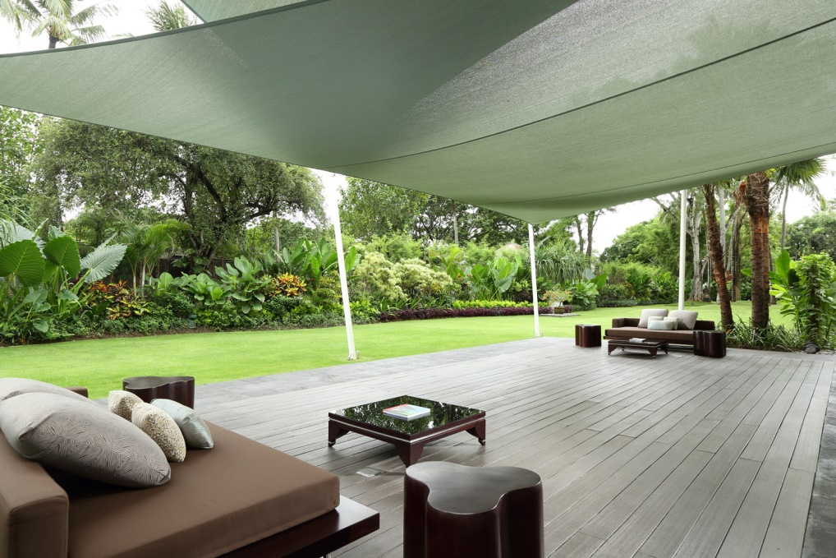
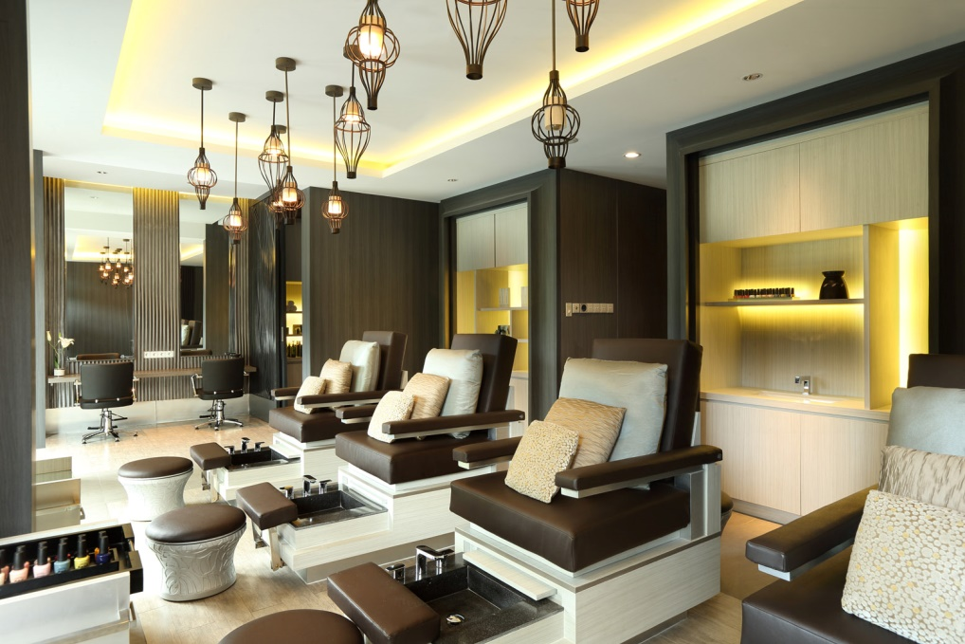
Himalayan Salt Wall Sauna
Shiatsu
Wellness Platform
Beauty Salon

Slide 33

Wellness at
Heavenly Spa By Westin™
Cultivate renewal with our resident Wellness Specialist – Jitendra Pokhriyal. Hailing from the birth place of yoga in India, Jitendra brings with him the ancient knowledge of yoga and meditation. Join our regular lifestyle sessions that focus on holistic wellness and draw on Bali’s traditional healing practices.

Slide 34

WESTINWORKOUT® FITNESS STUDIO

Slide 35

TENNIS COURTS

Slide 36

Westin Heavenly Bed
Designed to provide deep sleep, the award-winning Heavenly Bed has given millions of guests the benefit of a superior night's rest.
Notes:
Please do let me know if you wish to elaborate the wordings
36

Slide 37


Slide 38


Slide 39


Slide 40


Slide 41


Slide 42


Slide 43


Slide 44

FLOOR PLAN

Slide 45

FLOOR PLAN

Slide 46
Room Capacity Chart –1st Floor
Meeting Room Name | Square Meter | Theatre | Class Room | U Shape | Banquet
Mangupura Hall | 1961 | 2300 | 1220 | n/a | 1080
Exhibition Hall | 1363 | 836 | 492 | n/a | 630
Auditorium | 588 | 506 built in seat
Hibiscus Room | 187 | 140 | 84 | 33 | 80
Frangipani Room | 187 | 140 | 84 | 33 | 80
Orchid Room | 187 | 140 | 84 | 33 | 80
Bougainville Room | 187 | 140 | 84 | 33 | 60
Bali VIP Room | 80 | 54 | 33 | 15 | 30
Nusa Dua Room | 47 | 50 | 27 | 15 | 30
Executive Room 1 | 25 | 30 | 12 | 15 | 20
Executive Room 2 | 37 | 45 | 18 | 21 | 20
Lily Room | 30 | Board Room 12 persons
The Café | 245 | 62 Lounge Set Up

Slide 47
Room Capacity Chart –2nd Floor
Meeting Room Name | Square Meter | Theatre | Class Room | U Shape | Banquet
Nusantara Room | 1404 | 1520 | 864 | 150 | 790
Exhibition Gallery | 1305 | 1200 | 680 | 123 | 840
Jakarta Room | 704 | 624 | 357 | 75 | 280
Surabaya Room | 110 | 70 | 36 | 24 | 40
Bandung Room | 90 | 72 | 42 | 24 | 50
Medan Room | 406 | 352 | 132 | 57 | 170
Manado Room | 273 | 216 | 96 | 57 | 140
Singaraja Room | 78 | 78 | 36 | 15 | 30
Karangasem Room | 78 | 83 | 36 | 18 | 30
Denpasar Room | 78/53/81 | 42/34/60 | 24/18/36 | 15/15/24 | 10/10/40
Lotus Room | 88 | 80 | 45 | 24 | 40
Jasmine Room | 88 | 85 | 45 | 30 | 40
The Lounge | 207 | 60 Lounge Set Up

Slide 48

Meeting Room Name | Square Meter | Theatre | Class Room | U Shape | Banquet
Mangupura Hall | 1961 | 2300 | 1220 | n/a | 1080
Notes:
48

Slide 49

Meeting Room Name | Square Meter | Theatre | Class Room | U Shape | Banquet
Nusantara Room | 1404 | 1520 | 864 | 150 | 790
Notes:
49

Slide 50

Meeting Room Name | Square Meter | Theatre | Class Room | U Shape | Banquet
Auditorium | 588 | 506 | n/a | n/a | n/a

Slide 51

Meeting Room Name | Square Meter | Theatre | Class Room | U Shape | Banquet
Exhibition Hall | 1363 | 836 | 492 | n/a | 630

Slide 52

Meeting Room Name | Square Meter | Theatre | Class Room | U Shape | Banquet
Exhibition Gallery | 1305 | 1200 | 680 | 123 | 840
Notes:
52

Slide 53

Meeting Room Name | Square Meter | Theatre | Class Room | U Shape | Banquet
Flower Room | 187 | 140 | 84 | 33 | 80

Slide 54

Meeting Room Name | Square Meter | Theatre | Class Room | U Shape | Banquet
Jakarta Room | 704 | 624 | 357 | 75 | 280
Notes:
54

Slide 55

Meeting Room Name | Square Meter | Theatre | Class Room | U Shape | Banquet
Bali VIP | 80 | 54 | 33 | 15 | 30

Slide 56


Slide 57


Slide 58
Inspiring Events

Slide 59





Notes:
Can we change the bottom 2 photos on this slide as they look old and boring!!! (Renny: done, please do let me know if it’s not good yet)

Slide 60










Slide 61











Slide 62






Group M – Property Branding
Group M – Property Branding
Group M – Property Branding
Group M – Property Branding
Group M – Property Branding
Group M – Property Branding

Slide 63






Samsung – Property Branding
Samsung – Property Branding
Samsung – Property Branding
Samsung – Property Branding
Samsung – Property Branding
Samsung – Property Branding

Slide 64




Awards

Slide 65
2017 Awards
Best Indonesia Leading Family Resort by Indonesia Travel Tourism Awards 2017/2018
Best Luxury Family Beach Resort, Country winner by 2017 World Luxury Hotel Awards
Best Luxury Family Hotel, Regional winner by 2017 World Luxury Hotel Awards
Best Luxury Hotel & Conference Centre, Regional winner by 2017 World Luxury Hotel Awards
Listed #1 on Top 10 Family Resorts in Bali by Holiday with Kids Reader’s Choice 2017
Luxury Wellness Spa, 2017 Global Winner by World Luxury Spa Awards
Luxury Family Restaurant for Prego, 2017 Regional Winner by World Luxury Restaurant Awards
Best Italian Restaurant for Prego (1st runner up) by Now!Bali’s Best Restaurant, Bar & Café Awards 2017
Best Spanish Restaurant for Velada Tapas Bar & Kitchen (2nd runner up) by Now!Bali’s Best Restaurant, Bar & Café Awards 2017
Best Japanese Restaurant for Hamabe (2nd runner up) by Now!Bali’s Best Restaurant, Bar & Café Awards 2017
Best Conference Hotels, Best in Travel 2017 by Smart Travel Asia
Best Large Hotel, 2017 International Hotel Awards
International Five Star Standard, 2017 International Hotel Awards
2017 Certificate of Excellence by TripAdvisor

Slide 66

Contacts
^{www.westin.com/bali}
Reservation.00035@westin.com

